Slide 1
EPR-CAT:
Emergency Preservation and Resuscitation for Cardiac Arrest from Trauma
Thomas Scalea, MD
Physician in Chief
R Adams Cowley University of Maryland Shock Trauma Center

Slide 2
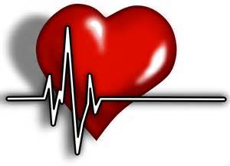
What is EPR?
EPR is a new medical procedure for trauma patients who suffer cardiac arrest due to massive blood loss and have not responded to standard care.

Slide 3
Why should I listen?
Traumatic injuries, like those caused by car accidents or a shooting, are the leading cause of death in people under the age of 45.
Any patient arriving at Shock Trauma who suffers a cardiac arrest after a penetrating trauma (such as a gun shot or stab wound) will be eligible to be enrolled in the study.

Slide 4
Why do we need EPR?
Patients who suffer a cardiac arrest from bleeding rarely survive
Less than 5% survive
Standard resuscitation techniques don’t work
Cooling patients to 50 degrees Fahrenheit may help…

Slide 5
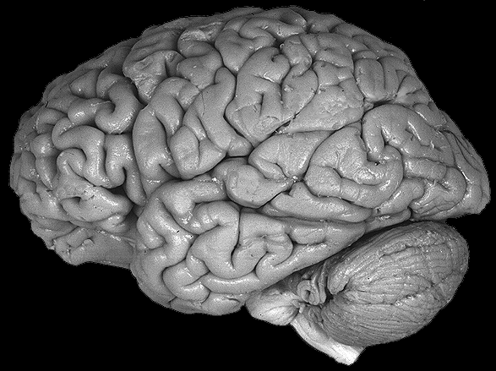
Why use hypothermia?
Intentional cooling of the brain, other organs and the entire body decreases the need for oxygen and may:
  Improve chances for survival
  Prevent organ system failure
  “Buy time” for surgeons to find and repair injuries

Slide 6
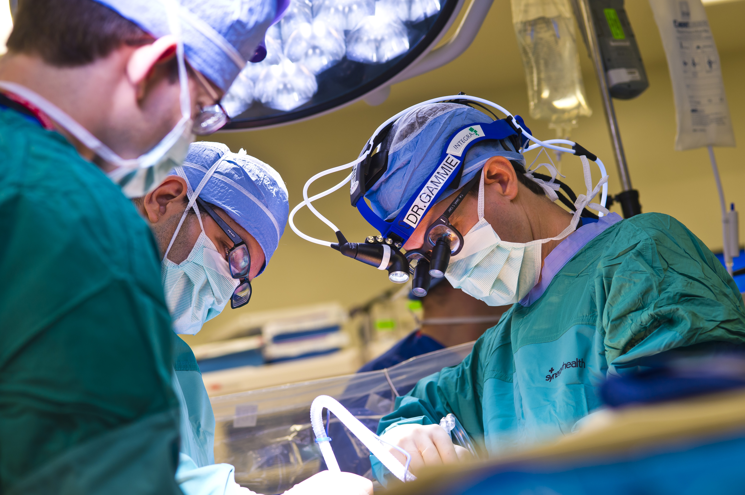
Hypothermia is…
Currently used for cardiac bypass surgery to protect the brain and other organs when blood flow is paused

Slide 7
What is the purpose of the EPR study?
To test the EPR procedure on:
Severely injured patients
In cardiac arrest
With massive blood loss

Slide 8
What is the goal of the EPR Study?
To improve survival for accident victims at risk of death from:
  Cardiac arrest
  Massive blood loss

Slide 9
Emergency Research: How it’s Different
Impossible to obtain permission or consent in emergency situations
Need to balance patient safety & improved patient care
Need to inform the community and gather public opinion
Enrolled patients can withdraw at any time
Community members can “opt-out” in advance

Slide 10

Risks and Benefits

Slide 11
Potential Risks
Device malfunction
Abnormal cardiac rhythms
Sepsis
Stroke
Blood clots
Bleeding
Organ failure
Victims may survive with brain damage
Death

Slide 12

Potential Benefits
Given the severity of these injured patients EPR may increase their survival rate
EPR patients would have otherwise died – fewer than 5% generally survive

Slide 13
Disclosure
One of the co-investigators conducting this research (Samuel Tisherman, MD) has a financial interest in intellectual property for the development of the EPR procedure and some of the associated hardware including special catheters and accessories which have been licensed to EPR Technologies. This means that it is possible that the results of this study could lead to personal profit for the individual investigator. This project has been carefully reviewed to ensure that patients’ well-being holds more importance than any study results. Dr. Tisherman will not be involved in the recruitment of research participants, and will not administer the informed consent process.

Slide 14
Want to learn more?
Visit us at http://www.EPRstudy.com
Register an opinion at open community meetings
Contact:
  Leslie Sult
  Clinical Research Nurse
  University of Maryland School of Medicine
  410-328-3272
  lsult@stapa.umm.edu

Slide 15
Sponsored By:
Department of Defense’s Telemedicine and Advanced Technology Research Center (TATRC)
University of Pittsburgh School of Medicine
R Adams Cowley University of Maryland Shock Trauma Center

