Slide 1
Patient Safety and Quality Improvement Symposium
University of Maryland Medical Center
May 12, 2014

Slide 2
Introduction & Welcome

Slide 3
Clinical Environment
Patient
Resident
Fellow
RT
RN
Pharmacy
IT
Attending
NP
Learning Environment

Slide 4
Anticipated Outcomes:
Post-Graduate Education
Competencies
Milestones
Case Logs
Scholarship
Certification
Recognition of Safety Vulnerabilities
Systems-Based
Intervene
Improve
Inter-professional Teamwork
Skills Maintenance
Maintenance of Certification
Healthcare Stewardship
Alignment with Safety Goals of Clinical site
Sustainable SBP, PBLI, PROF
Notes:
CMS, JC, AHRQ, PFP, MO

Slide 5
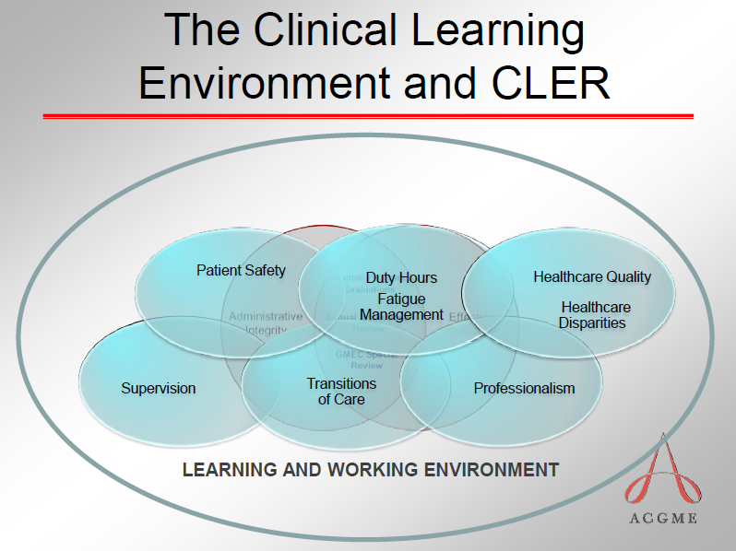
Notes:
The retreat/symposium is a starting point, at UMMC to begin to address the expected outcomes of graduate medical education, in order to meet the challenges of the future health care needs..

Slide 6

Medical Error: A Patient’s Story

Slide 7
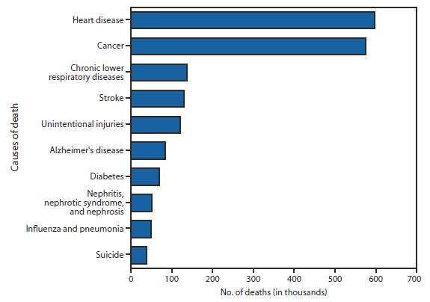
Leading Causes of Death
597,689
574,743
138,030
Preventable adverse events (PAEs) associated with death: 210,000 – 400,000
129,476
120,859
83,494
IOM To Err is Human (1999): 98,000
Hoyert DL, Xu J. Deaths: Preliminary Data for 2010. National Vital Statistics Reports; 2012: 61(6).
James JT. A new, evidence-based estimate of patient harms associated with hospital care. J Patient Saf; 2013: 9(3).

Slide 8
GME and Public Responsibility
“The ACGME's public stakeholders have heightened expectations of physicians. No longer accepting them as independent actors, they expect physicians to function as leaders and participants in team-oriented care.”
Institutional Requirements:
Oversight, education and implementation of PSQI.
Core Program Requirements:
“The program director must ensure that residents are integrated and actively participate in interdisciplinary clinical quality improvement and patient safety programs.”

Slide 9
Clinical Learning Environment Reviews
Patient Safety – including opportunities for residents to report errors, unsafe conditions, and near misses, and to participate in inter-professional teams to promote and enhance safe care.
Quality Improvement – including how sponsoring institutions engage residents in the use of data to improve systems of care, reduce health care disparities and improve patient outcomes.
Transitions in Care – including how sponsoring institutions demonstrate effective standardization and oversight of transitions of care
*Residents/fellows receive progressive education and training on quality improvement that involves experiential learning..

Slide 10
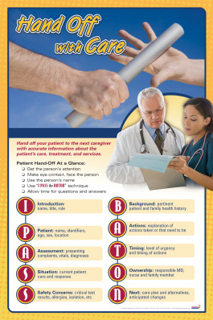
Medical Error: Hand-overs of Care
Close to 70% of sentinel events are due to failures in communication.
At least half of these result from failures in communication during handoffs.
Joint Commission International. Robert Wood Johnson Foundation [online]. [cited 2009 Apr 13]. Available from Internet: http://www.jointcommissioninternational.org/Robert-Wood-Johnson-Foundation.

Slide 11
Improving Care Processes at
UMMC:
Performance Innovation

Slide 12
PI Vocabulary: Safety
Safety: freedom from preventable harm; involves undesirable outcome
  Healthcare acquired infections
  Falls with injury
  Medication errors with harm
  Pressure ulcers
  Procedural misadventures (wrong site, retained objects)
  Delays in diagnosis or treatment (FTR)
  Failure to prevent (CLABSI, VTE)

Slide 13
PI Vocabulary: Quality
Quality: maximizing the likelihood of a desirable outcome
  Evidence-based care
  Core measures
  Safety
  Reliability
  Minimization of unintended variation

Slide 14
PI Vocabulary: High reliability
A highly reliable organization demonstrates:
  Prevention: Preoccupation with failure through a continuous search for “near misses” and detailed prevention strategies
  Resilience: the ability to react to and deal with adverse events
  Reluctance to simplify: invite “fresh eyes;” root cause analysis
  Organization around teams that are trained to work collaboratively
  Situational awareness, mindfulness and flexible decision structures; deference to expertise (ground truth, front line)
  Change management and robust process improvement (Lean and Six Sigma); (JC)

Slide 15
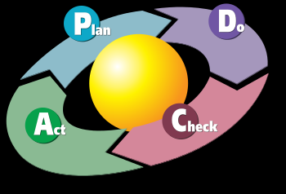
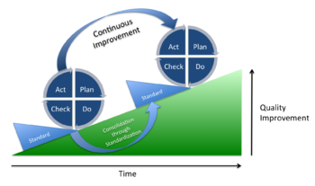
Robust Process Improvement: W. Edwards Deming
Elementary Principles of Statistical Control Quality The Union of Japanese Scientists and Engineers (transcript of Deming's 1950 lectures)
Shewhart, Walter Andrew (1939). Statistical Method from the Viewpoint of Quality Control. New York: Dover.

Slide 16
Lean / Six Sigma
“Lean and 6-σ are like the Democrats and the Republicans in the U.S. Congress”
  they both think they are right, and that you are wrong if you don’t agree with them
  very few from one side ever change sides
  some of their methods and decisions are sub-optimal
  each adds balance to the process when applied reasonably and knowledgeably

Slide 17
Lean
Reducing or eliminating waste
Improving flow
Increasing speed
Requires both technical and cultural change
Mile-wide, foot-deep
2-4 weeks
First-pass
1. Easier 2. Better 3. Faster 4. Cheaper

Slide 18
Six Sigma
Reducing process variation
Reducing defects
Addressing complex problems
Requires both technical and cultural change
Foot-wide, mile-deep
Three-six months
Refine the improvement

Slide 19
PDCA Cycle
Do
Check
Adjust (Act)
Plan

Slide 20
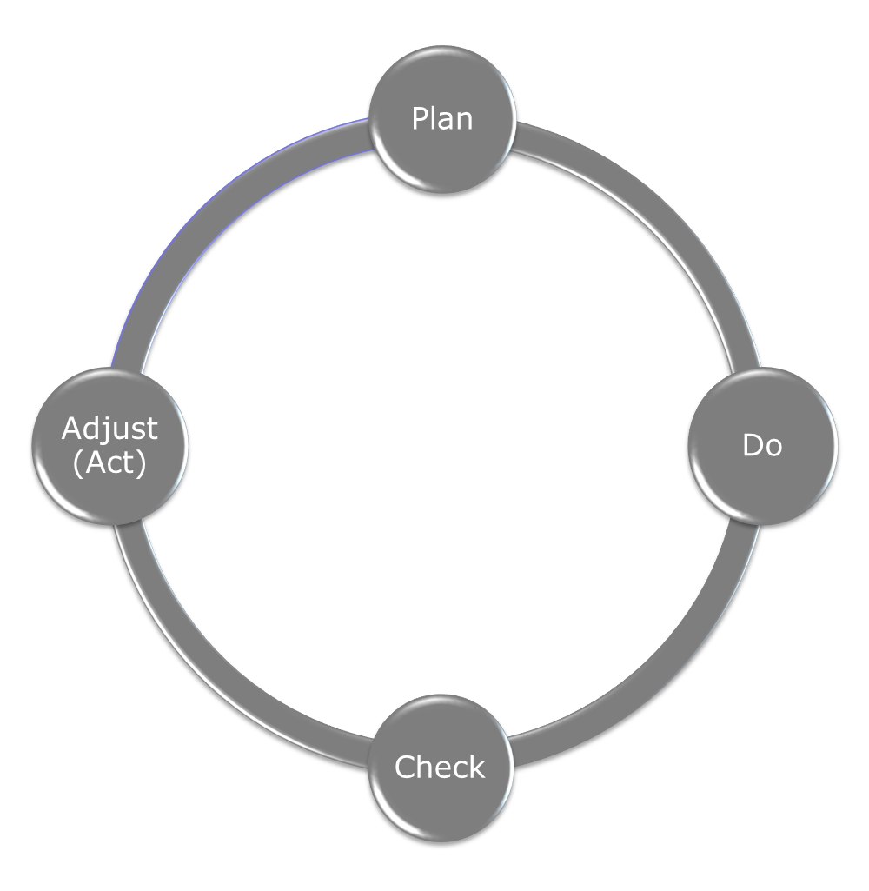
design
6-σ DMAIC
measure
analyze
control
improve

Slide 21
design
Lean A3
Reason for Action
Current State
measure
Target State
analyze
Gap Analysis
Learnings & Insights
Solution Approach
Rapid Experiments/ Projects/ Just-Do-Its
Completion Plan
control
improve
Confirmed State

Slide 22
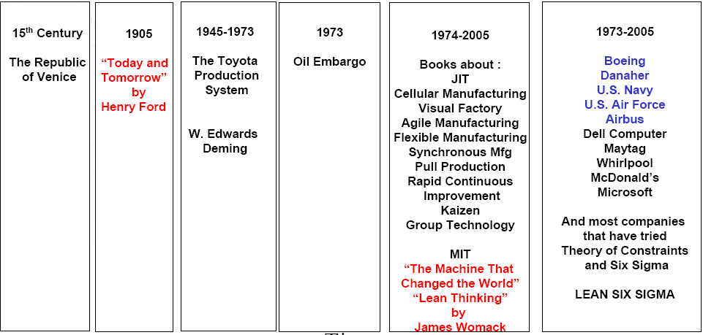
Lean Timeline

Slide 23
Lean fundamentals: Waste
Defects
Over-production
Waiting
Non utilized talent
Transportation
Inventory
Motion
Excess Processing

Slide 24
Lean fundamentals: Waste
Defects:
Over-production:
Waiting:
Non utilized talent:
Transportation:
Inventory:
Motion:
Excess Processing:
medication errors, CLABSI
unnecessary testing
duh
searching, counting
movement of patients
overstocked medications
rounding on many units
filling out duplicate forms

Slide 25
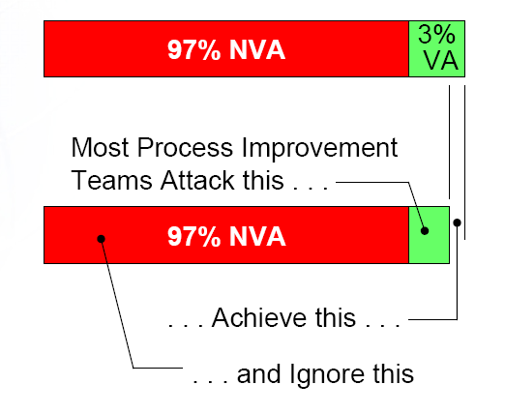
Lean fundamentals: Waste
C. Fiore;Lean Strategies for Product Development, ASQ, 2003

Slide 26
Lean fundamentals:
Root Causes of Waste
1.Layout (distance)
2.Long set-up time
3.Poor work methods
4.Lack of training
5.Functional organizations
6.Technology Gaps
7.Little understanding of the entire process
8.Historic supervisory roles
9.Irrelevant performance measures
10.Lack of workplace organization
11.Supplier quality/reliability
12.Poor communication
13.Avoidable interruptions
14.Complexity

Slide 27
Lean Toolbox:
1.Value Stream Maps
2.Rapid Improvement (Kaizen) Events
3.Education
4.Employee Involvement
5.Metrics and Alignment
6.Flow Cells
7.Standard Work
–Capacity Analysis
–Takt Time / Cycle Time
Standard Ops Worksheet
–Production Control Board
8.5S / Visual Controls
9.Pull/Kanban Systems
10.Brainstorming
11.Prioritization
12.Spaghetti Chart
13.Poka-Yoke / Mistake Proofing
14.Set-up Reduction
15.Total Productive
11.Prioritization
12.Spaghetti Chart
13.Poka-Yoke / Mistake Proofing
14.Set-up Reduction
15.Total Productive Maintenance
16.Change Management
17.SIX SIGMA
18.Chaku-Chaku / Load-Load
19.Heijunka / Load Leveling
20.Bottlenecks
21.Point-of-Use Delivery
22.DFMA
23.Control Charting
24.Pareto Analysis2
5.Histograms
26.Root Cause Analysis
27.5 Why’s
28.Hypothesis Testing
29.Production Process Preparation (3P)

Slide 28
Lean fundamentals: Process Map
SUPPLIERS
Vendors
Pharmacy
CSP
Laundry
Payers
CUSTOMERS
Patient
Family
Payer
Physicians
Employer
PROCESS
Admission
Authorization
Evaluation
Documentation
Scheduling
Consultation
Ordering
Peri-Procedural Care
Education
Discharge
INPUTS
Patient
Clinicians
Drugs
Equipment
Support Staff
Authorization
Orders
OUTPUT
Patient Experience
Clinical Outcome
Reimbursement
Hand Off

Slide 29
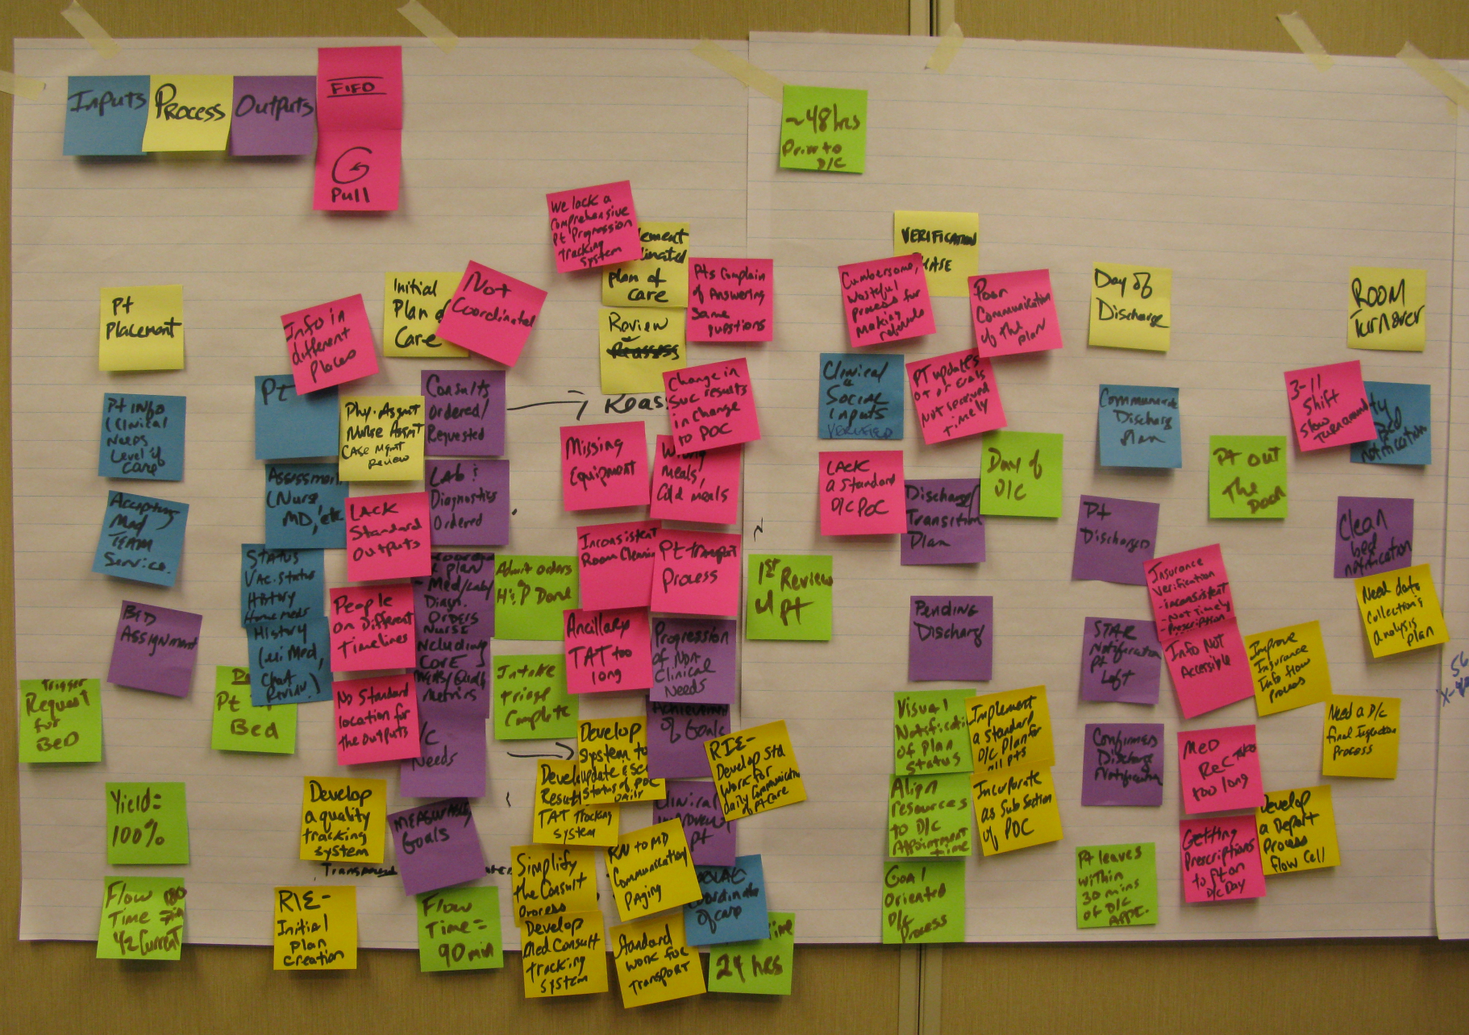
UMMC Process Map: Inpatient Medicine

Slide 30
Lean fundamentals: Metrics
Cycle Time (Laboratory Turnaround Time; ED LOS)
Inventory (expired meds)
Productivity (scans/MRI scanner/day)
Defects
Square Feet (foot print)
Set-up Time (housekeeping bed turnover time)
Quality Metrics (% AMI patients discharged with ASA)
People Travel
Product Travel
Volume
Crew Size (FTE)
Safety/Ergonomics
Cost (dollar value)

Slide 31
Lean fundamentals: Metrics
Cycle Time (Laboratory Turnaround Time; ED LOS)
Inventory (expired meds)
Productivity (scans/MRI scanner/day)
Square Feet (foot print)
Set-up Time (housekeeping bed turnover time)
Quality Metrics (% AMI patients discharges with ASA)
People Travel
Product Travel
Volume
Crew Size (FTE)
Safety/Ergonomics
Cost (dollar value)
If it’s not measured it can’t be improved
Measure results, not compliance
Don’t reward “A” but hope for “B”
Expose, measure and confront problems
Don’t substitute workarounds for standard work

Slide 32
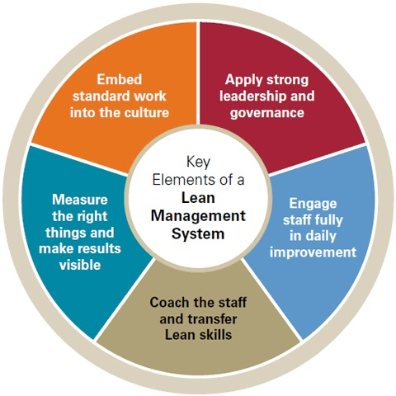
Lean Leadership

Slide 33

Boeing 737 Final Assembly: Before

Slide 34

Boeing 737 Final Assembly: After

Slide 35
Lean fundamentals: the “A3”
The “A3” started life as a communication tool for quality improvements and to get consensus when making decisions
Toyota used the “A3” to systematically guide people through the decision making process

Slide 36
The Use of the “A3”
It should be a presentation- without a presenter
Just reading it should convey the story
Too many words will bore people

Slide 37
The Story
The critical part of a “A3” is that it tells the story (like a story board for a film)
  Use pictures, diagrams, graphs….
It is rooted in PDCA, and will reflect a sound grasp and mastery of lean tools
It follows a logical and standard structure (improved over the years)
  Yet there are many different versions
Remember the purpose of your “A3”, and tell the story

Slide 38
design
Toyota Production System; “Lean”
1
Reason for Action
Do
Check
Adjust (Act)
Plan
2
Current State
measure
3
Target State
analyze
4
Gap Analysis
9
Learnings & Insights
5
Solution Approach
Rapid Experiments/ Projects/ Just-Do-Its
Completion Plan
6
8
control
improve
7
Confirmed State

Slide 39
TITLE:__Create a reliable hand-off process
Date Started:_12 May 2014______Current Date: 12 May 2014
Team:_GME Committee_and Colleagues_________
Review Team: _____________________________
1. Reason for Action
4. Gap Analysis
7. Completion Plans
2. Initial State
5. Solution Approach
8. Confirmed State
3. Target State
6. Rapid Experiments
9. Insights

Slide 40
Initial State: Where are we at UMMC?

Slide 41
Initial State
Time for a Poll

Slide 42
Percentage of Resident/Fellow Participation in Safety/QI

Slide 43
How do residents report errors?
To risk management
Dedicated conference to report collections of errors/near misses
Morning report
Rounds
Directly reporting errors to the appropriate personnel (ex. Pharmacy)
Daily chart audits
Sign out
Monthly QA
Via specific departmental protocols
Program director notified
Team debriefing
M&M conference (weekly, monthly, quarterly, yearly)
Built in error reporting system on PACS
Chief residents notified
Attending notified
Team discussions

Slide 44
Resident QI Activities
Presenting M&M conferences
Presenting QI grand rounds
Departmental longitudinal projects
Root cause analysis presentations
Individual projects
Involvement in departmental QI task force
Assigned projects
Committee participation
Involvement in hospital initiatives (CAUTI/CLABSI)
Formatting bundles/checklists

Slide 45
Transitions of care (Handoffs): Current State

Slide 46
Patient Care Hand-overs: Current State
-3 programs observed
  Content
  Team and resident contact info not present on any hand-over documents for 2 programs
  1 program without any of the following:
  Medications
  Allergies
  Code status
  Active clinical issues
  Anticipated issues and what to do
  Pre-populated to-do list
  Team follow-up list
  Family contact info

Slide 47
Patient Care Hand-overs: Current State
Delivery
1 program: 20% of hand-overs, no active clinical issues communicated
1 program: 50% of hand-overs absent HPI, only active clinical issues
All programs: 50% without anticipatory guidance (If/then)
All programs: Read back performed < 5% of the time

Slide 48
Patient Care Hand-overs: Current State
-
    Environmental
    Distractions occurred > 95% of the time
      Overhead paging/announcements
      Multiple people signing out in same room at same time
      General chatter
    Interruptions occurred > 20% of the time
      Answer pages
      Answer phone
      General chatter

Slide 49
Patient Care Hand-overs: Current State
Medicine Intern Hand-over Outcomes by Site
January 2012
Variable | Full Cohort | Site 1 | Site 2 | Adjusted p –value*
Face-to-Face | 99.5% (211/212) | 100% (109/109) | 99% (102/103) | †
Questions asked | 85.3% (180/211) | 93.5 % (101/108) | 76.7% (79/103) | <0.01
Number of Questions Mean (SD) | 1.4 (3) | 1.5 (3.8) | 1.2 (2) | 0.14
Private Location | 91% (193/212) | 96.3% (105/109) | 85.4% (88/103) | †
Written Document | 95.8% (203/212) | 96.3% (105/109) | 95.1% (98/103) | 0.67
Distracting Location | 12.3% (26/212) | 6.4% (7/109) | 18.5% (19/103) | 0.06
Interruptions | 41.3% (86/208) | 49.1% (53/108) | 33% (33/100) | 0.03
Number of Interruptions Mean (SD) | 0.8 (1.4) | 1.1 (1.8) | 0.5 (0.8) | <0.01
* comparing site 1 and site 2. All values adjusted for repeated sampling by clustering at the intern and observer levels
† results too collinear to perform adjusted analysis

Slide 50
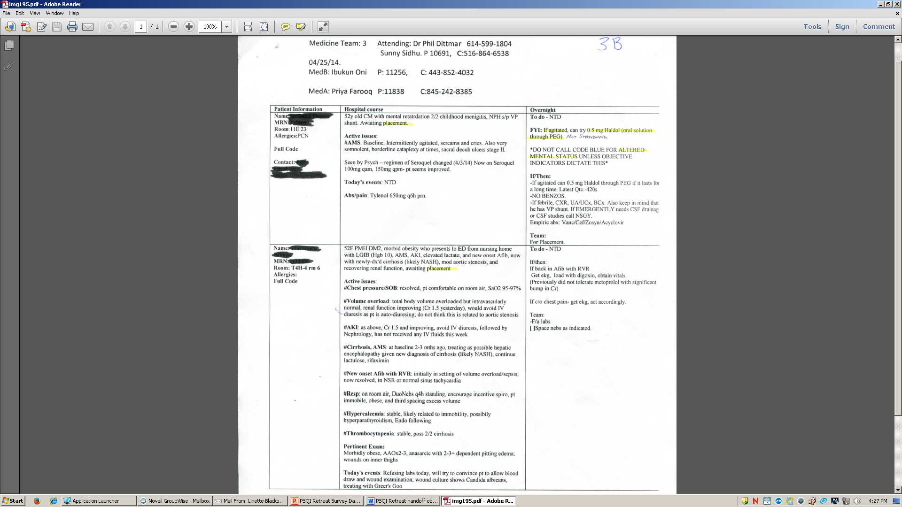
1
Dr. Someone C: 555-666-5678
Resident: Stevie Steve Pager 33377 C: 555-666-1234
Intern A: Joe Smith Pager 11155 C: 555-555-1234
Intern B: John Jones Pager 22266 C: 555-555-5678

Slide 51
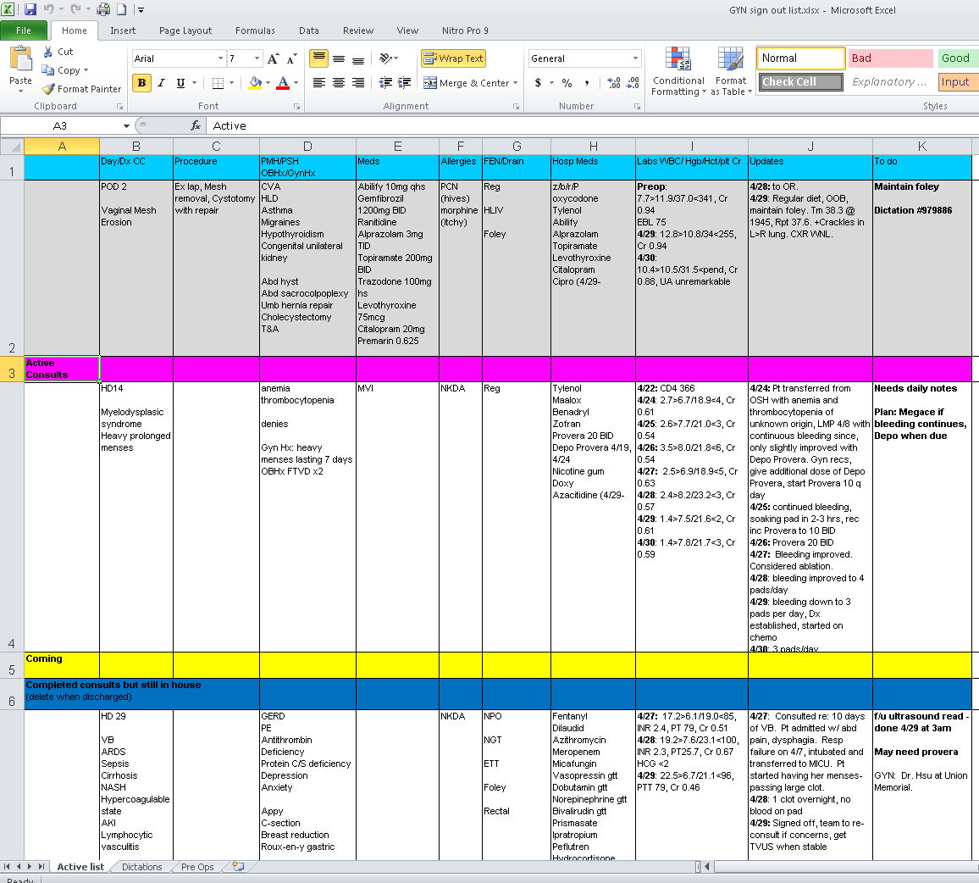

Slide 52
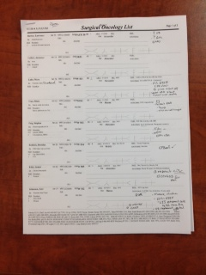

Slide 53
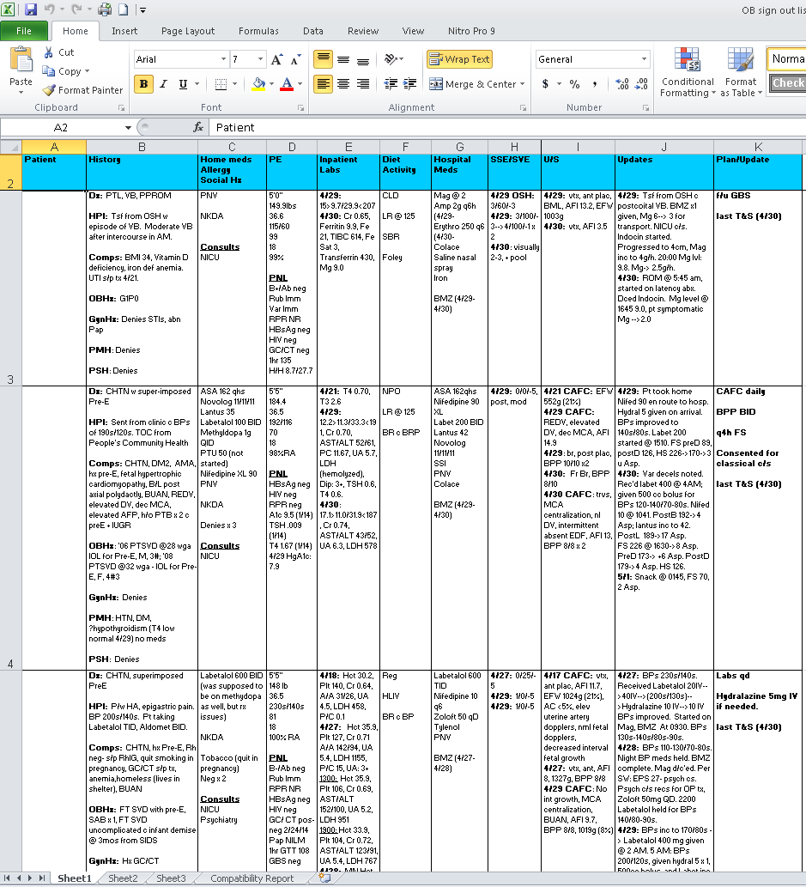

Slide 54
What does a Good Hand Off look Like?
-Target State

Slide 55
Target State: Standardized Process
Content: template
    MR#
    Name
    Location
    Active meds
    Allergies
    Code status
    Current patient condition
    Active clinical issues
    Anticipated issues and what to do
    To-do List
    To follow-up list
    Attending name & Contact info
    Resident and Team name & Contact info (e.g pager #)
    Family contact info

Slide 56
Target State: Standardized Process
Delivery
  Structured verbal process
  Active issues identified
  Assessment of patient and problems
  Plan of care
  Anticipatory guidance (e.g. If-Then statements)
  Read-back performed
  Opportunity to ask and respond to questions

Slide 57
Target State: Standardized Process
Environmental
Performed face-to-face
Non-distracting location
No interruptions

Slide 58
Metrics: What measurements can we put in place to assess and answer
“what does good look like?”

Slide 59


Slide 60
Gap Analysis: What’s in the way of the achieving the Target State today?

Slide 61
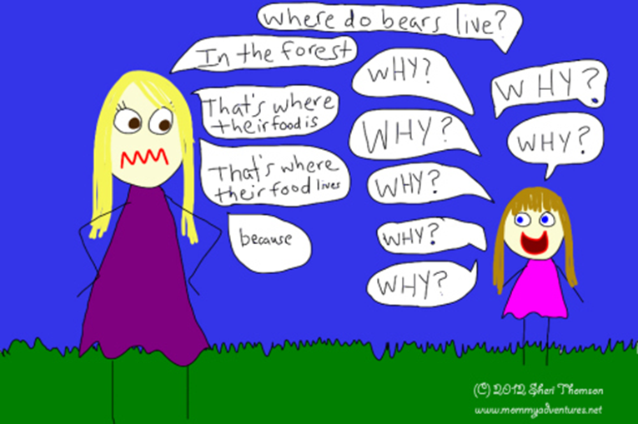
Asking the Whys…….

Slide 62

The Washington Monument was disintegrating
Why-Use of harsh chemicals
Why- To clean pigeon droppings
Why- so many pigeons- they eat spiders and there are a lot of spiders at monument
Why- so many spiders? They eat gnats and lots of gnats at monument
Why- so many gnats? They are attracted to the light at dusk

Slide 63
Solution approach: What general things can we try to get closer to the Target State?

Slide 64
Tests of Change:
(Improve, Act, Experiments)
Just Do Its: What things can we accomplish within the next few days that will address some of the gaps?
Rapid Experiments: What things do we need to dig into a little deeper- over the next month or so- by doing a little more analysis, measurement, multidisciplinary brainstorming and “trystorming?”
Projects: What things do we think will require longer term efforts (next 6 months) to put into place?

Slide 65
Small Group Group Exercise

Slide 66
The Washington Monument was disintegrating
Why-Use of harsh chemicals
Why- To clean pigeon droppings
Why- so many pigeons- they eat spiders and there are a lot of spiders at monument
Why- so many spiders? They eat gnats and lots of gnats at monument
Why- so many gnats? They are attracted to the light at dusk
Solution: Turn on the lights at a later time

Slide 67
Target State: Standardized Process
Content: template
    MR#
    Name
    Location
    Active meds
    Allergies
    Code status
    Current patient condition
    Active clinical issues
    Anticipated issues and what to do
    To-do List
    To follow-up list
    Attending name & Contact info
    Resident and Team name & Contact info (e.g pager #)
    Family contact info

Slide 68
Target State: Standardized Process
Delivery
  Structured verbal process
  Active issues identified
  Assessment of patient and problems
  Plan of care
  Anticipatory guidance (e.g. If-Then statements)
  Read-back performed
  Opportunity to ask and respond to questions

Slide 69
Target State: Standardized Process
Environmental
Performed face-to-face
Non-distracting location
No interruptions

Slide 70
Target State: Standardized Process
Other
Age, Weight, Gender
Recent labs
Procedures done
In-patient vs Out-patient
Pnemonic to characterize illness severity
Special considerations: ex. Religious preference, access
Contact info: chain of command, consult teams
Read back by receiver

Slide 71
Restraints, contact precautions

Slide 72
Gap Analysis
System Output: integration with EMR vs physical document
Education: HIPPA compliance, tools, sharing format, legal
Setting: space, computer access, free of distractions
Time: Auto-population, Link to call schedule
Information Mgt: How much? Deletion of impertinent info
Staffing: lack of…
Centralization: Documentation, Format, Access
Patient/Service Volume
Accountability, Oversight, Supervision, Enforcement
Modify-able Tool
Assess Effectiveness

Slide 73
Gap analysis
Sign out time, Interruptions
If…then…
Sustainability
Education—ex. CRISP, integration of electronic systems that “talk to each other”, when? -- during orientation
Elevation of importance – competency, formal training
Site specific challenges
Departmental Buy-In—same tool, collection/collation of specialty specific items
Tablet-based/portable info management

Slide 74
Solution Approach
Contact Each Program: know/share time for sign out, name of contact, sign on door
RN: dynamic call blocking during sign out (**caution**), cohort pages
Define/Establish Location
Designate Team Member to manage calls during sign out
Team Sign Out
Automated Delete on To-Do List—requires updates
Designate Departmental Champion(s) – supervision, enforcement
Involve mid-level providers
Use Technology to modernize process

Slide 75
Solution approach
Use current EMR, adapt to current needs
Manage volume of the service w/o compromising learning experience
Quality Assessment & Improvement, integrated into process
Cultural change—”this is MY patient”
Limit/manage information
Assign name of care team in EMR
Surveys: RN
Education: On-going, conferences, review of documentation
Incentive: build relationships with other team members
Observe: “secret shopper”
Emulate successful teams, Share with HSA

Slide 76
Metrics
Near misses, LOS
Resident “happiness”
RN satisfaction
Observation, Secret Shopper
Time tracking, time study
missing information, frequency, how often do you need to use the chart
Receiver assessment of quality, content
Quantify interruptions,
during “no call time” is there harm, balancing measures
# tasks completed or required after sign out
Audit sign out sheets

Slide 77
Milestone – communication

Slide 78
Recommendations & Action Plan
Education: IHI Modules
Patient Safety
Quality Improvement
Transitions of Care/Hand Offs
Report Back
Use A3, become departmental champion
When & What Format
Report to GME, in 1 month

