Slide 1
Resident & Fellow Portfolio Training Program
Summer 2024
Alissa Stieber, MSN, RN
Clinical Informatics Training Supervisor

Slide 2
What is Portfolio?
The Portfolio suite of applications uses Epic, Cerner, and other application tools to help refine and improve system processes that will help us reach our goal of One UMMS. Here are some of the great things the platform offers:
Enhanced clinical decision making
Better continuity of care among multi-disciplinary care teams
Improved decision making by leaders that are able to study trends in patient outcomes
Information sharing with the majority of health systems in and around Maryland
Increased information access and use to help reinforce patient-focused healthcare

Slide 3
Portfolio Epic Training
Project Management:
Starting in April - 30 minute weekly huddles with Maureen Hyson, Stacey Small, and Sheera Nowlin to track milestones and deadlines.
Portfolio Training Management (PTM):
Manages Portfolio Epic Training
PTM will enroll all trainees in training sessions.
Training assignments depend on which departments the trainees will be completing their clinical rotations in.
A registration email will be sent from UMMS U to the coordinators and the trainees containing the training details.

Slide 4
2024 Portfolio Epic Training Changes
Primary training sessions will be combined self-directed, interactive modules for Ambulatory and Inpatient Residents
Taking approximately 5 hours
The following trainings require that primary training modules be completed prior to attending additional training sessions
Portfolio Epic Resident AMB/Inpatient Training | Self-Directed Modules
Portfolio Epic Provider Ortho (15 min) | Self-Directed Modules
Portfolio Epic New Hire Optime Surgeon Provider
Portfolio Epic New Hire Stork Provider
Portfolio Epic Provider Cardiology Interventional
Portfolio Epic Provider Oncology Outpatient/Inpatient
Portfolio Epic Provider Transplant
Portfolio Epic Provider Surgeon Transplant

Slide 5
2024 Portfolio Epic Training Changes
All additional training sessions will be conducted virtually
Virtual Sessions will be in 2 or 4 hour time blocks
Training Titles
Portfolio Epic Provider Anesthesia – 4 hrs
Portfolio Epic Provider Cardiology Interventional –2 hrs
Portfolio Epic Provider ED – 4 hrs
Portfolio Epic Provider Inpatient Behavioral Health – 4 hrs
Portfolio Epic New Hire Stork Provider Session – 4 hrs
Portfolio Epic Provider Radiology IR – 2 hrs
Portfolio Epic New Hire Optime Surgeon Provider Session – 2 hrs
Portfolio Epic Provider Oncology Outpatient/Inpatient - 4 hrs
Portfolio Epic Provider Transplant – 2 hrs
Portfolio Epic Provider Surgeon Transplant – 2 hrs

Slide 6
Scheduling Process
DUE:
March 29, 2024
Coordinators will complete the Resident Enrollment form for each program.
April 2024
The training team will host a Q & A Session for Coordinators to discuss any Portfolio Epic training questions.
DUE:
April 15, 2024
Portfolio Training Schedule will be finalized.
May/June 2024
Coordinators will submit an access form for each trainee.
June/July/August 2024
Trainees will attend Portfolio Epic Training.
DUE:
May 15, 2024
Coordinators verify access to Access Portal and UMMS U
DUE:
May 1, 2024
2024 Program Resident List sent to Training and Scheduling leads.
Programs must train together as a group. This helps the trainers and the trainees!

Slide 7
Deadline Dates
Date
March 29 | Resident Enrollment Form Completion for all programs
April 15 | Training schedule finalized
April 22 | Communication and confirmation of dates/times of training sent to coordinators
May 1 | 2024 Program Resident list sent to Training/Scheduling Leads
May 15 | Coordinators verify access to Access Portal and UMMS U
May 31 | Coordinators submit access form for each trainee attending training in June
May 31 | PTM will assign trainees to sessions for June
June 7 | Coordinator will verify Resident assigned training for June
June 26 | PTM will assign trainees to sessions for July
June 28 | Coordinators submit access form for each trainee attending training in July
July 1 | Coordinator will verify Resident assigned training for July

Slide 8
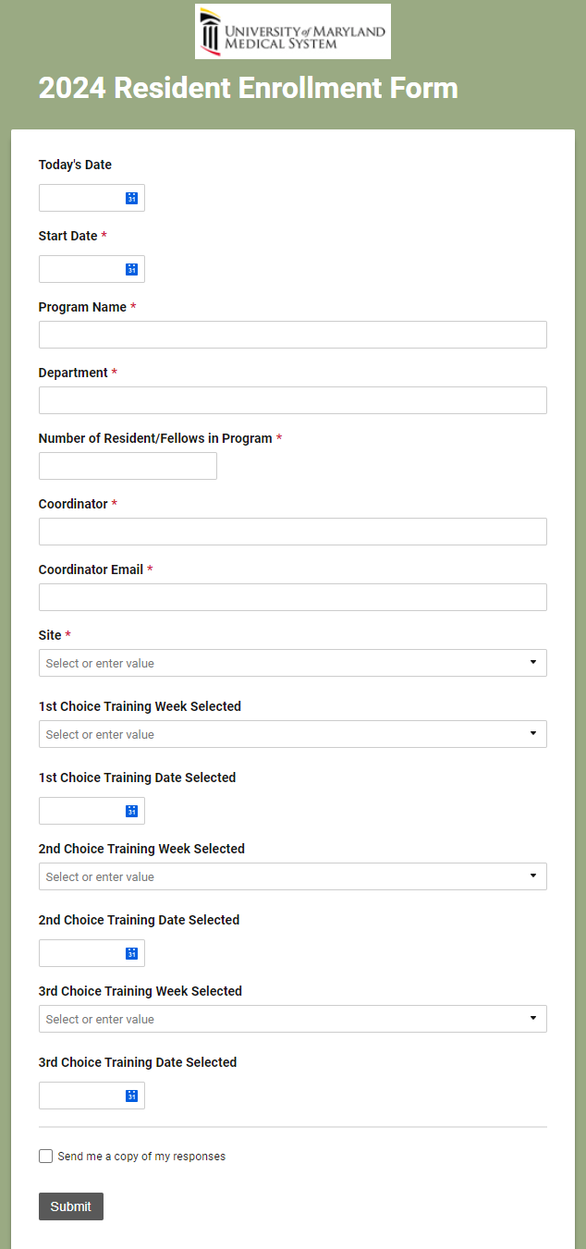
Resident Enrollment Form
2024 Resident Enrollment Form (smartsheet.com)
Submit 1 form for each Program
Choose 3 tentative weeks and dates for training
Programs must train together as a group
Include the number of residents/fellows
Recommendation to check box to receive a copy of responses

Slide 9
Program Resident Lists
Please complete 2024 Program Resident List including all Residents/Fellows within the program.
1 program per document
Send to Alissa Stieber – Astieber@umm.edu and Debi Artist – Deborah.Artist@umm.edu

Slide 10
Portfolio Epic Access Requests
Access Request Portal:
Employee Center Homepage - UMMS Service Center Portal (service-now.com)
Access Requests:
Access Requests should be submitted through the service desk portal.
Epic System access will be granted within 24 hours of training completion, following the No Training, No Access policy.

Slide 11
Access Requests-UMMS ServiceNow Portal
Click on Request Access

Slide 12
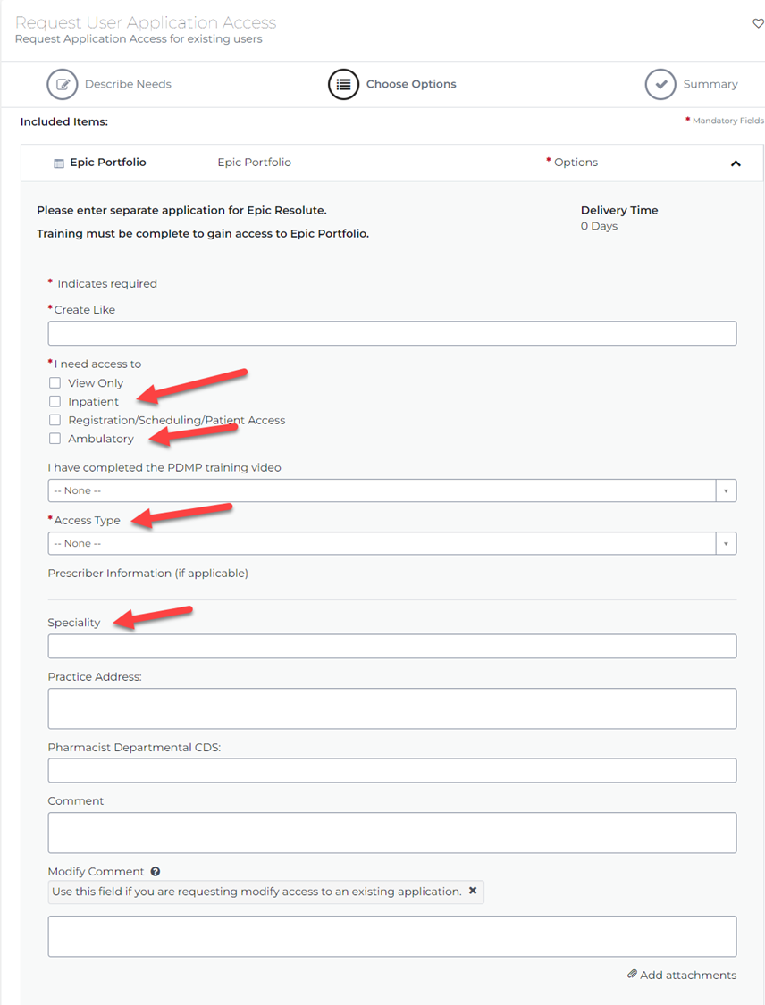
Access Requests
Create Like - Name of a previous Resident in the same program
I need Access to - Inpatient and/or Ambulatory
Access Type - New User to Epic
Specialty - Program Name

Slide 13
Friendly Reminders
Primary trainings are self-directed and can be completed at any time.
Additional training sessions will be conducted virtually.
There is no test out option.
Coordinators should be listed as the Manager in UMMS U and will receive a copy of training notifications.
Encourage trainees to arrive on time for training sessions and log into sessions early.
Training sessions will begin at 8am and 1pm.
Coordinators need to verify that ALL Residents/Fellows have training assigned per each program
It is expected that coordinators will adhere to the training dates and times that are established and assigned.
For assistance, please call the Helpdesk - 410-328-4357 and select option #3.

Slide 14
Contacts
Alissa Stieber is the Portfolio Training lead for the Residents & Fellows Program
Debi Artist is the Portfolio Scheduling lead for the Residents & Fellows Program
Darren Witherspoon is the Project Manager for the Residents Portfolio Epic Training

Slide 15
Questions

