Slide 1
Harnessing
the Power of Faculty
Stephen M. Kavic, MD
Professor of Surgery

Slide 2
Disclosures
No financial disclosures
I am entirely dependent on the state of Maryland

Slide 3
Why Me?
“You got the wrong guy”

Slide 4
Overview
Problems
Difficulties
How to approach solutions

Slide 5
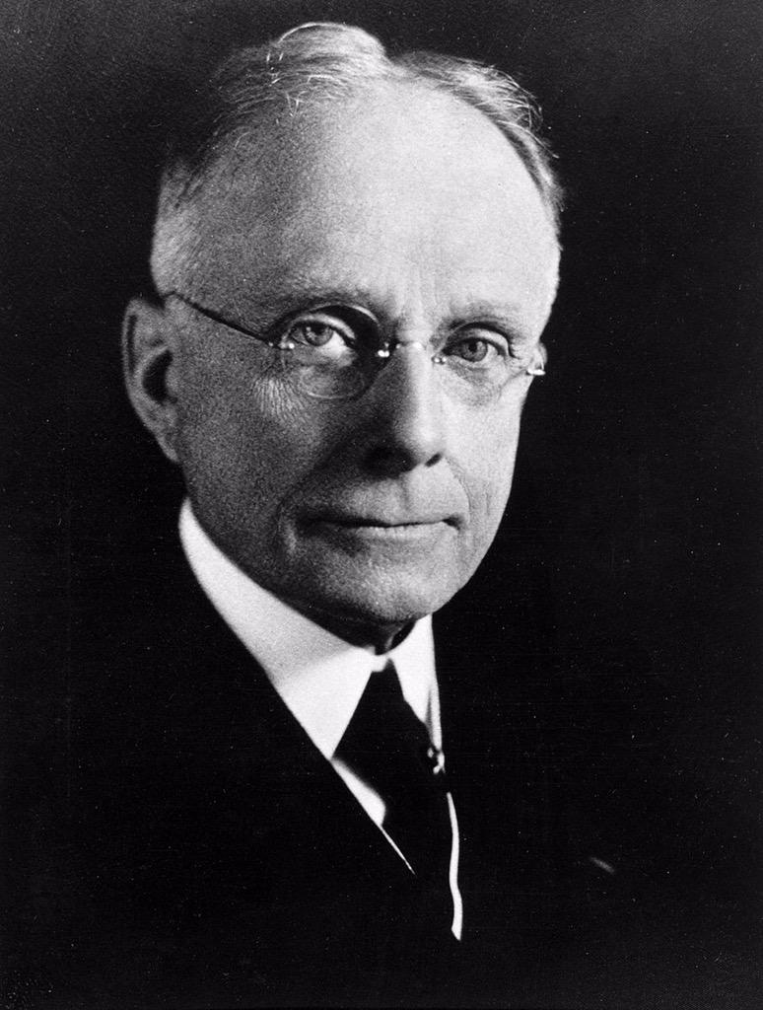
Chevalier Jackson
“In teaching the medical student, the primary requisite is keeping him awake”
circa 1905

Slide 6
Faculty Corollary
In teaching medical students,
the primary requisite
is getting the faculty to show up

Slide 7
Progression of Lecture Scheduling
Identify need for lecture on thyroid disease on 3/17
Fill with a “volunteer”
Hear of last-minute cancellation
Get angry
Fill in as speaker
Feel like no one cares

Slide 8
Cycle of Disappointment
Kubler-Ross stages of grief?
Denial Resident
Anger Fellow
Bargaining Asst Prof
Depression Assoc Prof
Acceptance Professor

Slide 9
You Can’t Do It Alone
Off-site rotations
We rely on others
Journal club
Lectures
Informal guidance/lunches

Slide 10
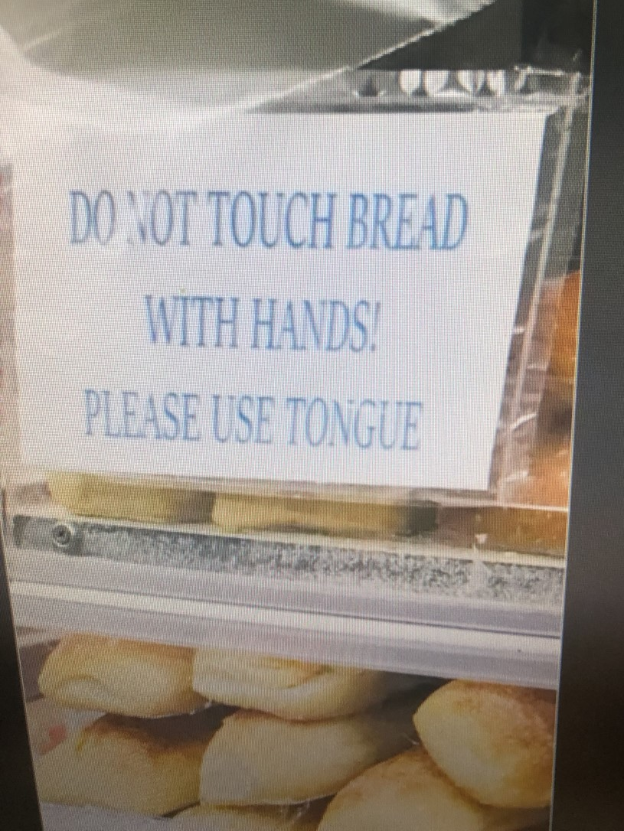
Difficulties
Time limits
Engagement
Feedback
Hanson ER. BMC Med Ed. 2022; 22: 363.

Slide 11
Program Requirements
Depends on specialty
Surgery:
n+1 (n= number of chief residents)
Anesthesiology:
Members must have specialized expertise in the subspecialties of anesthesiology
Provide adequate supervision…which shall not vary with the time of the day or the day of the week

Slide 12
Total Faculty
Minimum number n+1 7
Actual clinical faculty 66
Number that I rely on <<66

Slide 13
Lean on Me
It is tempting to go back to the same well
Don’t lean on “the teacher”

Slide 14
Repetition
A great lecture x 1 is
A good lecture x 2 and
Causes a riot by time 5

Slide 15
Problems for Faculty
Focus on student-driven, problem-based approach results in fewer opportunities for faculty to showcase their expertise
National trend of decreased medical student attendance at live lectures
Hanson ER. BMC Med Ed. 2022; 22: 363.

Slide 16
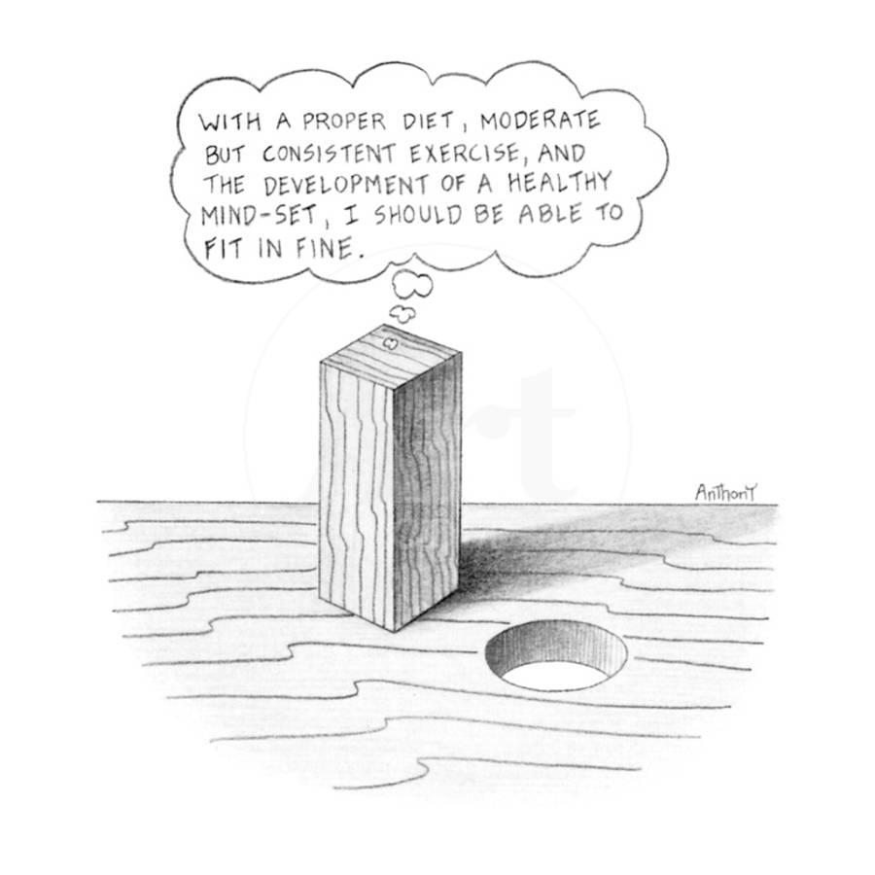
Identify Talent
Harder than it looks
Listen to expertise

Slide 17
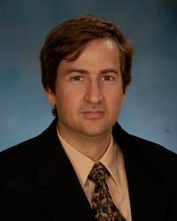
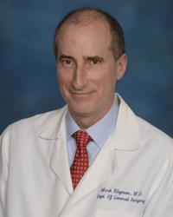
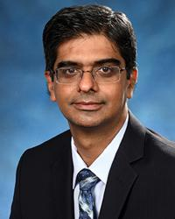
Motivation
Right person and right role
Medical student
Resident
Fellowship

Slide 19
Intrinsic/Extrinsic Motivation
Engagement includes rational, emotional, and behavioral components
Intrinsic: purpose, mastery, autonomy
Extrinsic: salary, recognition, reward
Zelek B. Can Med Ed J. 2018; 9: e68.

Slide 20
Reported Motivation
Personal satisfaction
Opportunity to attract students to specialty
Prestige
(Not money, contract, peer pressure)
Dahlstrom J. BMC Med Ed. 2005; 5: 27.

Slide 21
Swedish Blood Donation
Three groups
Voluntary
Paid
Paid, but immediately donated
Donation
52%
30%
53%
Mellstrom. J Eur Econ Assoc. 2008; 6: 845.

Slide 22
Recognizing Physician Engagement
Consistently say positive things about organization
Tend to stay
Strive to achieve beyond expected daily role
Clark J. The Kings Fund. 2012.

Slide 23
Faculty Development
Success is no accident
Set people up for success
Easy introduction –
provide lecture for new faculty

Slide 24
General Teaching Techniques
Learner-oriented teaching
Questioning
Presentation skills
Goal setting
Mentoring
Coaching
Creativity

Slide 25
Example: Dictations
Residents dictated operative notes
Went to a transcriptionist
Days later, reviewed by attending
One to two weeks later, feedback:
“we used 3-0 suture, not 2-0”
“that wasn’t great”

Slide 26
Practice Dictation
Done at end of case
Verbal sparring with resident
Shows teacher what the learner has experienced
Immediate feedback
Provides review of case for practitioner

Slide 27
Purpose
Demonstrates expertise of faculty
Increased teaching reputation
Low cost, low cognitive workload
Sets up ask for more teaching

Slide 28
Faculty Development
Most faculty have no training on becoming successful teachers, just role models
Mentoring
Career decision-making
Research guidance
Study skills
Team leadership
APDS.org

Slide 29
Recognizing Physician Disengagement
Recognize that which will fail
Lack of pleasure in teaching
Excessive clinical load
Disengaged with material
Clark J. The Kings Fund. 2012.

Slide 30
Harnessing Faculty
Recognize teachers
Develop more teaching
Spread the educational wealth

Slide 31
Thank you
skavic@som.umaryland.edu

