Slide 1
Program Director Wellness, Resilience, Longevity
Nirav G. Shah, MD
Professor of Medicine
Associate Chief, PCCM, Education and Faculty Development
Assistant Dean for Medical Education

Slide 2
Program Director Pro-Con List
Mentorship
Growth
Learning
Leadership
Protected time
Paperwork
Accreditation
Stress
Time
Pressure

Slide 4
Balance

Slide 6
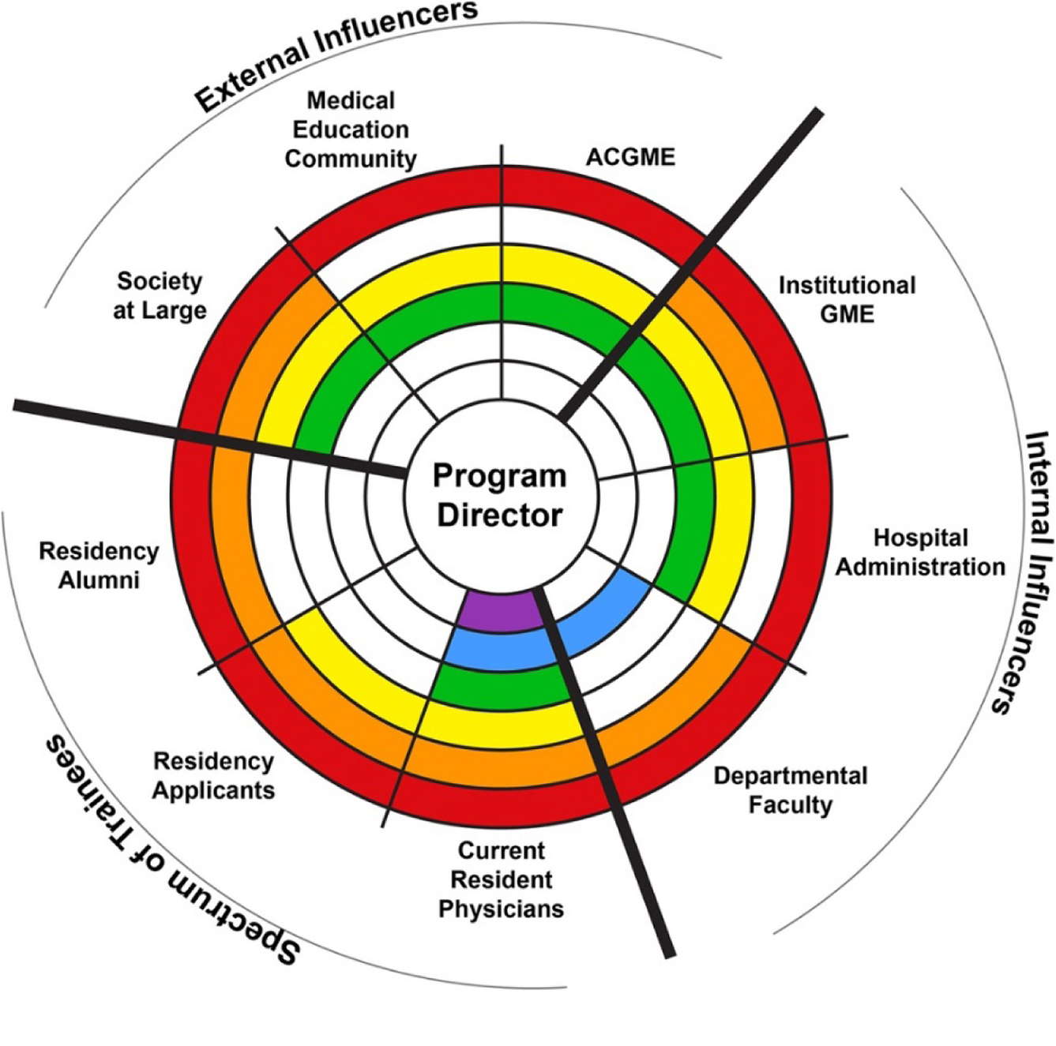
Organize and Implement Curricula
Evaluate Trainee Performance
Provide Meaningful Instruction
Be a Role Model
Advocate for the Trainee
Kumar, Swee, Suneja. BMC Medical Education 2019.

Slide 7
Core Features of Successful PDs
Authority
Accessibility
Adaptability
Authenticity
Accountability
Autonomy

Slide 8
Ultimate Goals
Increase productivity while working
Make meaningful contributions
Create effective teams and relationships
Be able to spend quality time with my family
Have fun and be fulfilled

Slide 9
Leadership Theory
Leadership is not defined by the position, but rather by the relationships with the trainees.

Slide 10
Academic Medicine: Tripartite Mission
Clinical Service
Deliver exceptional patient care
Teaching
Train the next generation of the health care workforce
Research and Scholarship
Conduct innovative research and/or share things that work for us

Slide 11
The Balance in our Daily Life
Clinical Service
Research
Teaching
Administration

Slide 12
Work Smarter, Not Harder
Having a clear strategy to prioritize my most important activities
Allows me to feel satisfied with my work and to enjoy coming to work each day
Helps me avoid feeling overwhelmed, overcommitted, frustrated, overworked
Prevents me from burning out

Slide 13
Professional Health and Wellness
The ethics of self-care:
“The medical academy's primary ethical imperative may be to care for others, but this imperative is meaningless if it is divorced from the imperative to care for oneself. How can we hope to care for others, after all, if we ourselves, are crippled by ill health, burnout or resentment?”
Cole, Goodrich & Gritz. “Faculty Health in Academic Medicine: Physicians, Scientists and the Pressures of Success.” Humana Press 2009; pg 7.

Slide 14
Professional Health and Wellness
The ethics of self-care: (cont.)
“…medical academics must turn to an ethics that not only encourages, but even demands care of self.”
Cole, Goodrich & Gritz. “Faculty Health in Academic Medicine: Physicians, Scientists and the Pressures of Success.” Humana Press 2009; pg 7.

Slide 15
How does a PD stay well?
Lifestyle
Healthy lifestyle: exercise, sleep, balanced diet
Network
Create a network that is supportive and additive
Get Involved
Get involved at the campus level, in the region, and nationally
De-stress
Manage stress: meditation, hobbies, therapy

Slide 16
Group Dynamics
1+1 = 2
But does it really?

Slide 17
Find a Group that Makes Everyone Better!
Team-work
Communication
Collaboration
Trust

Slide 18
What did this actually mean for me?

Slide 19
My Journey: from the bench to the classroom
2009
Assistant Professor, Assistant PD for PCCM
Clinical focus: ICU, EBUS
Research focus: Thermobiology
Teaching focus: GME
2017
Associate Professor, PD for PCCM
Clinical focus: ICU, ILD
Research focus: Minimal thermobiology
Education collaboration
Teaching focus: GME, UME
2019
Assistant Dean for Curriculum, Associate Chief for PCCM
Clinical focus: ILD, some ICU
Research focus: Curriculum development UME/GME
Teaching focus: UME, GME
2022
Professor of Medicine, Assistant Dean for Medical Education
Clinical focus: ILD, some ICU, some inpatient pulm
Research focus: Curriculum development UME/GME
Teaching focus: UME, GME
2014
PD for PCCM
Clinical focus: ICU, Pulm
Research focus: Thermobiology
Teaching focus: GME
Much more Administration

Slide 20
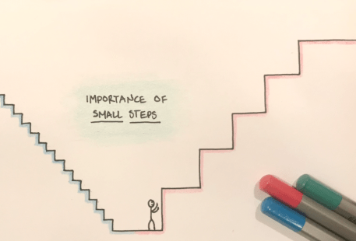
Big Goals

Slide 21
What comes after being a PD?

Slide 22
The Balance in our Daily Life
Clinical Service
Research
Teaching
Administration

Slide 23
What Roles Have Followed after being a PD?
Vice Chair for Education, Dept of Medicine (OHSU)
Vice Chief for Education & Faculty Development, PCCM (Penn)
Director of the ILD Program and Associate Chief for Clinical Affairs (UMSOM)
Associate Division Head (Henry Ford)
Associate Dean of Medical Education (Ohio State)
Assistant Dean for Faculty Affairs (Indiana)
President of ATS, Department Chair, President & CEO AAIM (Vermont)
President of Chest, Director of Preclinical Foundations Curriculum (Emory)
Chief Academic Officer, AMA (Hopkins)
DIO (UMMC)

Slide 24
Find the things you want to fill your Thali with. Know that you have support at UMSOM. Cherish the moments, the people, and the twists and turns of the journey – that is the fun part.

Slide 25
Thank you!!
Nirav G. Shah, MD
ngshah@som.umaryland.edu
@ngshah1

