Slide 1
Professional Identity Community of Practice Creating a Space for Discussions on Professional Identity Tensions in GME
Peter H Jin, MD
Associate Program Director for Adult Neurology Residency

Slide 2
Sources of Tension in GME Trainees
Imposter phenomenon
Hard and conflicting feedback
Fallout from medical errors
Workplace abuse
Setting boundaries
Disagreement with superiors
Loss of joy for work and stagnation
Morals and values vs. service and duties

Slide 3
Professional Identity Formation
Can we teach professional identity?
Are we equipped to teach these topics?
How do we create significant learning experiences involving professional identity?
The development of “professional values, moral principles, actions, aspirations, and ongoing self-reflection on the identity of the individual”
Wald HS. Acad Med. 2015;90(6)

Slide 4
Starting a Community of Practice
In 2020, we created a new morning report format titled “Wellbeing at Work” where faculty led discussions with neurology residents on topics in professional identity tensions
Naturally addressed barriers of psychological safety and collaboration
Highlighted the human dimensions of our work
Respected the (beautiful) complexity of professional identity
A community of practice is a “persistent, sustaining social network of individuals who share and develop an overlapping knowledge base, set of beliefs, values, history and experiences focused on common practice and/or mutual experience”
Cruess RL. Acad Med. 2018;93(2)

Slide 5
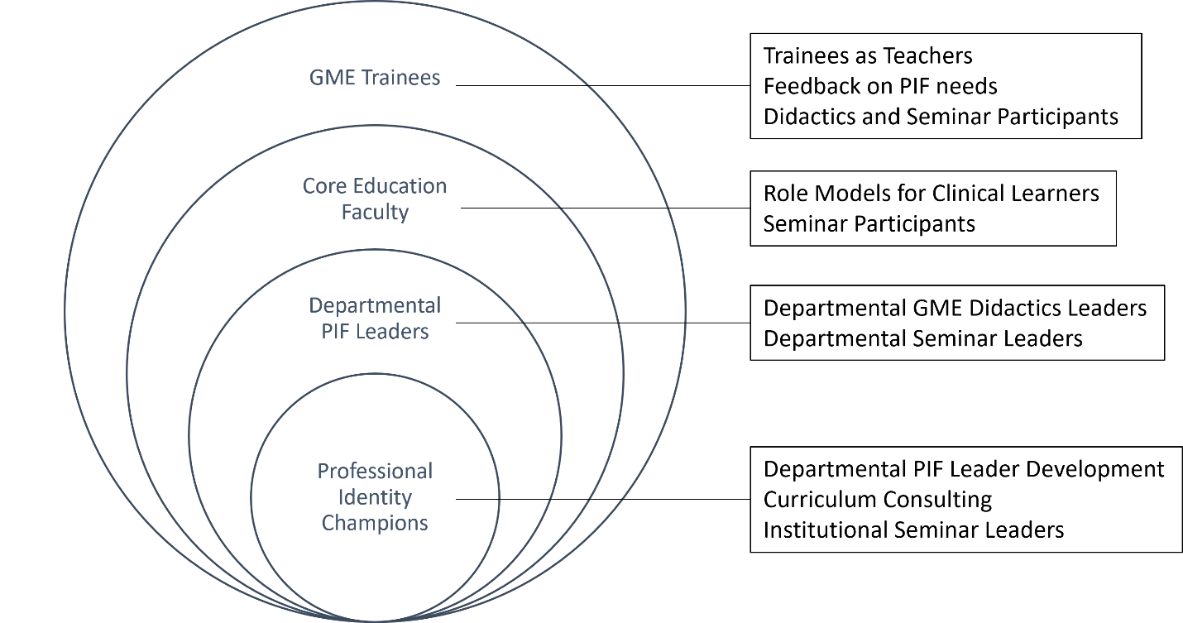
The Bigger Community
pjin@som.umaryland.edu

