Slide 1
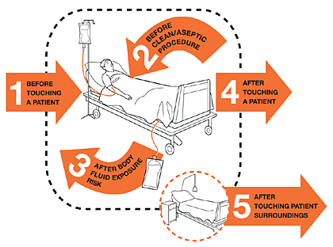
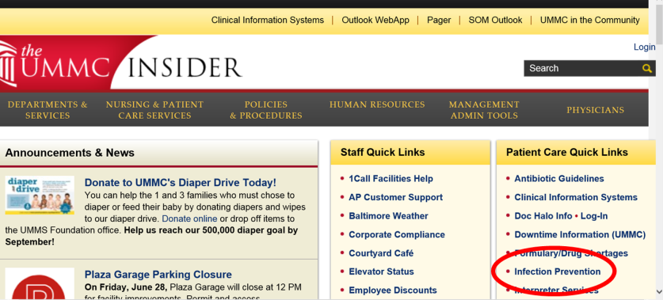
WEEK 1
HAND HYGIENE
Hand hygiene is the MOST BASIC and ESSENTIAL PRACTICE to prevent infection
PERFORM:
On ENTRY and EXIT from patient’s room
BEFORE sterile and clean activities
Donning / doffing PPE (ex. gloves)
Preparing sterile supplies
Just before a sterile procedure (ex: line or catheter insertions)
Accessing any intravascular device
Wound dressings
Moving from contaminated to clean area (ex: groin to trach)
PERSONAL PROTECTIVE EQUIPMENT (PPE)
Equipment worn to minimize exposure to a variety of infectious materials
DONNING ORDER
Hand hygiene
Gown & gloves (gown must be tied around waist)
IF mask/face shield/googles/respirator is required, don as first step, then do hand hygiene immediately before wearing gown and gloves (mask must cover nose and chin)
DOFFING ORDER Remove in a manner that prevents self-contamination
Gown & gloves (turn gown inside out during removal process)
Hand hygiene
Goggles or Face shield; Mask or Respirator
Hand hygiene
PERSONAL PROTECTIVE EQUIPMENT
ONLY visitors of patients on contact isolation for MRSA and/or VRE do not need to wear PPE. However, they must be instructed on performing hand hygiene.
SHARED EQUIPMENT DISINFECTION
Disinfect shared patient equipment in between patient use, regardless of isolation
4Ds of disinfecting shared patient equipment:
DONE: done performing patient care
DITCH: ditch the gloves and perform hand hygiene
DON: don a new pair of gloves
DOOR: disinfect the equipment at the door
Refer to label on disinfectant container for dwell/kill time
WE ARE ON THE INTRANET!!!
http://intra.umms.org/ummc/departments/infection
click on “INFECTION PREVENTION” under the Patient Care Quick Links on The UMMC Insider homepage

