Slide 1
Chief Resident Academy Organization and Delegation
Jason W. Custer, MD
Associate Professor of Pediatrics
Pediatric Critical Care Medicine
Medical Director – Pediatric ICU

Slide 2
Complex System of Academic Medicine
Patients – increasing complex
Learners – many different levels, many different learning styles
Administration – Hospital, School of Medicine, Department
Regulation – Joint Commission, ACGME, Insurance Companies
People with lives outside of work
How do you want to spend your time?

Slide 3
 | Urgent | Not Urgent
Important | I | II
Not Important | III | IV
Fire Fighting
Quality Time
Relationship Building, Planning
Distractions
Time Wasting

Slide 4
Work in Quadrant 2 – Quality Time
Organization and Planning
What do you want to accomplish this year?
How will you get to know your residents as people?
What is your plan to get to know the rest of the multi-disciplinary team?
How will you develop a different relationship with your program leadership that will enhance you as a professional?
Important to have a sense of the day to day work but not to lose the big picture of your goals for the year
Never assume that people know what to do
Never assume that all residents are like you – there is a reason you are a chief resident

Slide 5
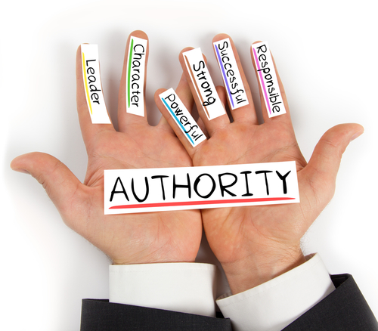
The Life Cycle of the Chief Year
First phase – Establishing Authority
Being an authority figure
Medical knowledge
Scheduling decisions
Managing people
Creating the culture, setting expectations and holding people accountable
Defining the work for the year, seeing what is important
Creating Trust

Slide 6
Leading effective meetings
Meetings Create Culture

Slide 7
Leading effective meetings
The first question

Slide 8
Leading effective meetings
Meetings create Culture – Create the Culture and Expectations Early in the Year
Start on time – expect that people show up on time
End on time or slightly early – respect other people’s time
Purpose – why do we need this meeting
Status – to update or inform
Decision – reach consensus
Discussion – identify alternatives
Agenda – create and share before the meeting
Logistics – when, where, who needs to be there

Slide 9
Life Cycle of the Chief Year
First phase – Establishing Authority
Second phase – Problem Solving
High level of Multi-discipliary work
Triage and delegation
Leverage expertise
Use your resources

Slide 10
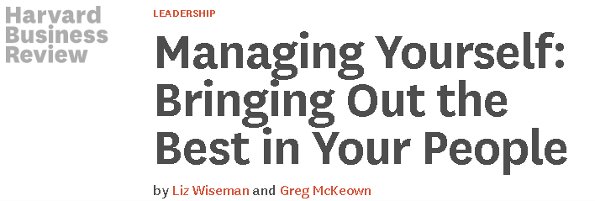
Multiplier vs. Diminisher
Diminisher
“Know it all”
Rescuer – not allowing people to learn from mistakes
Having all of the answers
Multipliers - Bringing out the best in people
Lead with questions
Allow space for others to think
Don’t have all the answers
Ask insightful questions

Slide 11
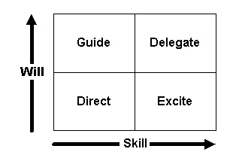
When to Delegate

Slide 12
Delegation
Delegation vs. Abdication
Make sure there is both skill and will to accomplish the task
Set expectations
Follow-up at regular intervals
Define what success is and publically praise

Slide 13
The Life Cycle of the Chief Year
First phase – Etablishing Authority
Second phase – Problem Solving
Third phase – Surviving
Up to 60% of physicians report signs of Burnout
Ensure connection to the Culture
Ensure connection to each other
Fostering Resiliency
What did your programs do?

Slide 14
The Life Cycle of Chief Year
First phase – Establishing Authority
Second phase – Problem Solving
Third phase – Surviving
Fourth phase – Transitioning – Leaving a legacy
Hardwire the changes that worked
Institutional memory – new interns don’t know it any other way
Set your successor up for success
Don’t check out too early

Slide 15
Lessons Learned
Avoid sliding up or down
Sliding up – see the residents as pampered, complainers
Sliding down - tend to side with the resident view rather than the administration
Don’t lose contact – meet regularly with program leadership
Avoid splitting – certain people will go to a certain member of the chief group that is more likely to give the answer they want
“I’ll bring it up at our chief’s meeting and get back to you”
Always look for systems level explanations rather than individual

Slide 16
 | Urgent | Not Urgent
Important | I | II
Not Important | III | IV
Fire Fighting
Quality Time
Relationship Building, Planning
Distractions
Time Wasting

