Slide 1
Diabetes November 16, 2022

Slide 2
Today’s Speaker
PRESENTER NAME: Angela Ginn-Meadow RN, RD, LDN, CDCES
Currently the Director of Baltimore Metropolitan Diabetes Regional partnership for UMMC. As a Diabetes Care and Education expert over the past 15 years she has improved clinical outcomes for patients. She is passionate about health, wellness and obesity prevention. As a community change agent for the development of wrap around services to improve social inequalities of health. Ginn-Meadow is a scientific advisor for the Grain Foods Foundation as she serves as a Diabetes Expert. She graduated with honors from Morgan State University with a Bachelor of Science in Food & Nutrition.
As a media expert & Past National Spokeswoman for the Academy of Nutrition & Dietetics she has been featured in Marie Claire, Food Network, Everyday Living, Prevention and Better Homes & Gardens, Essence and Dr. OZ , just to name a few.
Areas of Expertise:
Diabetes Food Preparation, Meal Planning, Behavior & Lifestyle Changes, Culinary Nutrition

Slide 3
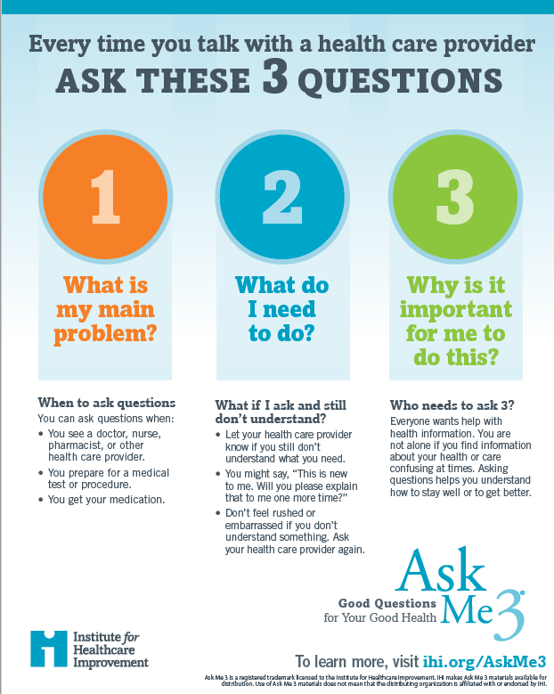
A Way to Take Charge- Use Ask Me 3®
Ask Me 3 is a program that suggests using three simple, straightforward questions when talking to your doctor, nurse, pharmacist or health care provider about your health:
What is my main problem?
What do I need to do?
Why is it important for me to do this?

Slide 4
Building a Better Plate for Diabetes Prevention & Management
Fat, Salt, Sugar & Our waistline!

Slide 5
Using Ask Me 3®
Statement (problem)
Q: I have a dark patch on my neck what could that be?
A: That can be a sign of Prediabetes/Insulin resistance. Prediabetes is a condition when the blood sugar is higher than normal but not high enough to be diagnosed with Type 2 Diabetes.
Q: What do I need to do to prevent diabetes?
A: In order to lower the risk of diabetes, you should lose at least 5% body weight and get active 150 minutes per week.
Q: Why is it important for me to do this?
A: Prediabetes can increase your risk of Type 2 diabetes, Stroke, Heart Disease and Neuropathy. You can prevent Prediabetes!

Slide 6
Prediabetes & diabetes Public Burden in Maryland
Healthy adults
1,351,479 (32%)
Overweight/obesity
1,575,829 (34%)
Diabetes
2,799,259 (66%)
Prediabetes
488,942 (10.5%)

Slide 7
Public Health Burden of Prediabetes
Prediabetes: 38% of US adults (~96 million!)
15-30% of people with prediabetes today will develop diabetes in the next 5 years
Prediabetes increases risk of premature mortality, CVD, neuropathy
~80% with prediabetes are unaware of their status

Slide 8
Prediabetes & Diabetes
Prediabetes:
A1c: 5.7-6.4%
Fasting: 100-125mg/dl
Diabetes:
A1c: >6.5%
Fasting: >126mg/dl

Slide 9
Are you at risk for Type 2 diabetes?
Have prediabetes.
Are overweight.
Are 45 years or older.
Have a parent, brother, or sister with type 2 diabetes.
Are physically active less than 3 times a week.
Waist line: > 40 inches (Men)
> 35 inches (Women)
Have ever had gestational diabetes (diabetes during pregnancy) or given birth to a baby who weighed over 9 pounds.
Are an African American, Hispanic or Latino, American Indian, or Alaska Native person. Some Pacific Islanders and Asian American people are also at higher risk.
If you have non-alcoholic fatty liver disease you may also be at risk for Type 2 Diabetes.

Slide 10
Ways to Prevent Type 2 Diabetes & Manage Diabetes
Lifestyle Changes- Diet & Exercise
Lifestyle Change Program (DPP Program)
Diabetes Self-Management Training

Slide 11
Fad Diets vs. Lifestyle
Carnivore Diet
Whole 30
Keto Diet
Atkins
Paleo
Mediterranean Diet
WW
Vegetarian Diet
Flexitarian Diet
DASH Diet
Low Fat

Slide 12
Recipe for disaster
Dyslipidemia
Hypertension
Impaired Glucose Tolerance
Insulin resistance
Excessive insulin production

Slide 13
Nutrients of Concern
Saturated Fat
Sodium
Simple Carbohydrates

Slide 14
Nutrients for Disaster
Saturated Fat
Solid at room temperature
Animal Fat
Contribute to dyslipidemia
Goal: <10% of total caloric intake from saturated fat

Slide 15
Nutrients for disaster
Saturated Fat
Common food items:

Slide 16
Nutrients for disaster
Sodium
Found in a variety of sources
Americans average about 3,300 milligrams of sodium per day, about 75 percent of which comes from processed foods
Aim for 2,300 mg (1 teaspoon of salt)
Existing Hypertension: Aim for 1,500 mg (1/4 tsp salt)

Slide 17
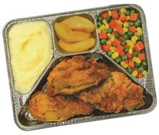
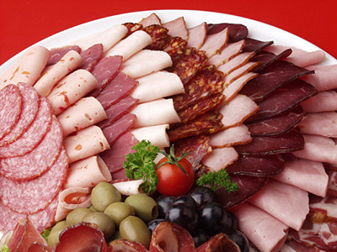
Nutrients of disaster
Sodium
Common sources:

Slide 18
Nutrients for disaster
Simple Carbohydrates
Added Sugar
Excessive calories
The average American consumes 22 teaspoons of added sugar a day, which amounts to an extra 350 calories.
Low in Fiber
Excessive insulin production
Aim for 100 calories per day ( 6 teaspoons)

Slide 19
Nutrients for Disaster
Simple Carbohydrates
Common forms of added sugar
Agave nectar | Evaporated cane juice | Malt syrup
Brown sugar | Fructose | Maple syrup
Cane crystals | Fruit juice concentrates | Molasses
Cane sugar | Glucose | Raw sugar
Corn sweetener | High-fructose corn syrup | Sucrose
Corn syrup | Honey | Syrup
Crystalline fructose | Invert sugar
Dextrose | Maltose

Slide 20
Your Recipe for success
Dietary Changes
+
Physical activity
= Quality of Life

Slide 21
Eating Healthy
Notes:
My

Slide 22
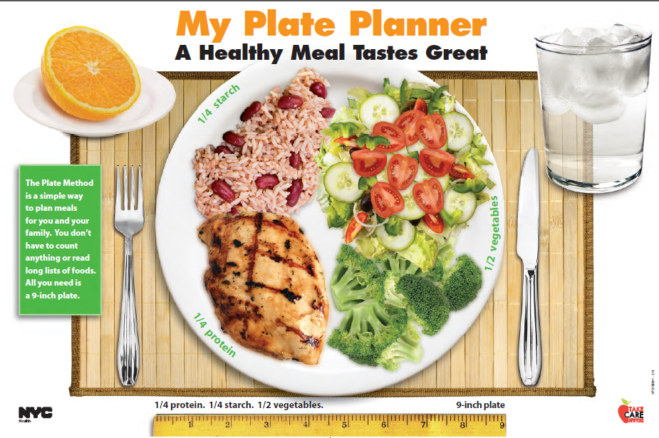

Slide 23
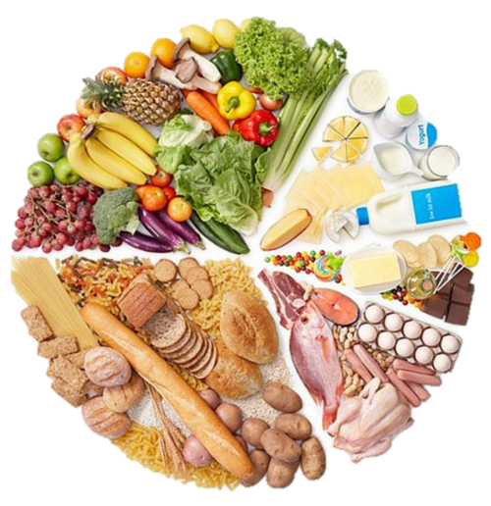
Macronutrients for success
Carbohydrates
Protein
Fat
We need all 3 for a balanced diet!
Fats
Carbohydrates
Proteins

Slide 24
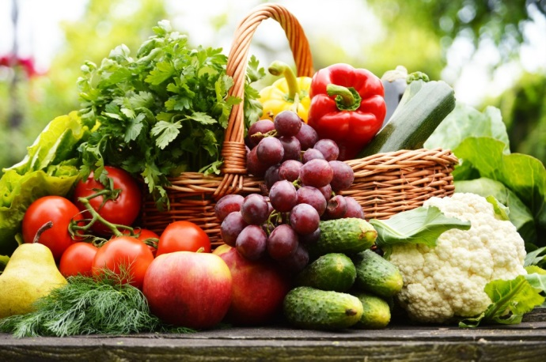
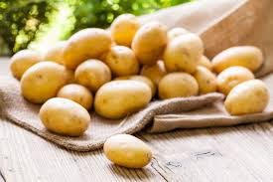
Carbohydrates
Fiber
Starch
Sugar
Vegetables
Fruit
Whole grains
Beans
Nuts
Potatoes
Corn, Peas
Grains, Pastas
Breads, Crackers
Chips, Cookies
Desserts
Sweets, Candies
Pastries
Ice Cream
Juice, Soda
Not all carbohydrates are equal!

Slide 25
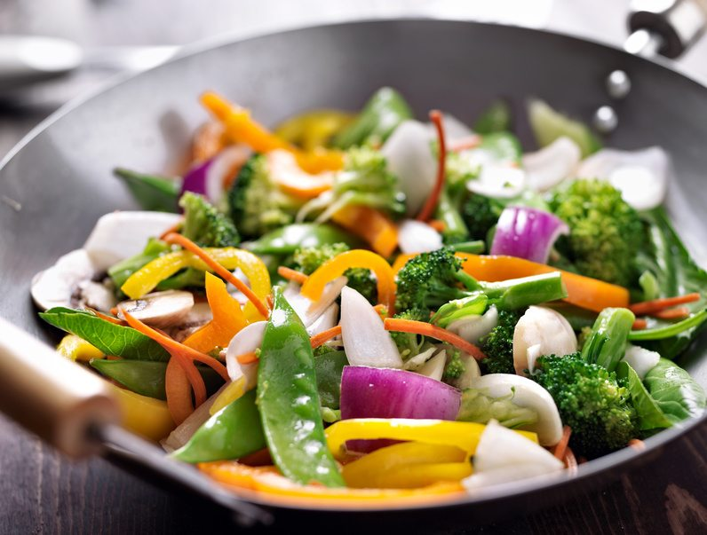
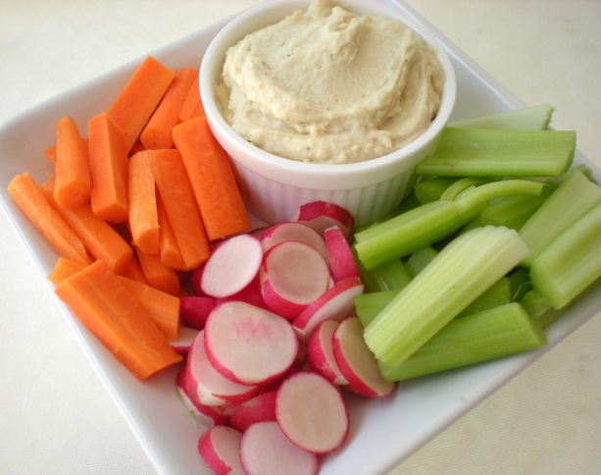
Fruits & Vegetables
Make 1/2 your plate vegetables.
Choose a variety of colors – eat the rainbow!
Aim for 3 vegetable servings per day
Aim for 2 fruit servings per day
Great source of fiber, vitamins and minerals!
Notes:
What are your ideas on ways to increase your fruit and vegetable intake?

Slide 26
Protein ¼ of your plate

Slide 27
Fats
Monounsaturated Fats
Polyunsaturated Fats
Saturated Fats
Trans Fats
Include in Small Portions
Limit
Avoid All
Olives
Avocado
Oils
Olive
Canola
Peanut
Nuts
Almonds
Cashews
Peanuts
Pecans
Pistachios
Nut butters
Fish
Walnuts
Oil
Flax
Grapeseed
Safflower
Sunflower
Flax, pumpkin, sunflower, sesame seeds
Cheese
Cream
Butter
Red meat
Steak
Lamb
Processed meat
Hot dogs
Bacon
Sausage
Deli meat
Sweets, desserts
Made by food manufacturers
Partially hydrogenated oil
Notes:
Fat is important. It provides satiety, essential fatty acids, energy storage, and insulates the body. Eating monounsaturated and polyunsaturated fats reduces the risk of heart disease, lowers cholesterol, and reduces inflammation.

Slide 28
Aim for Foods High in Fiber
Eating more fiber can help you:
Feel more satisfied after eating
Lower blood cholesterol
Keep blood glucose on target
Help you go to the bathroom more regularly
Reduce your risk for colon cancer
Women
25 grams/day
Men
38 grams/day

Slide 29
Tools for Learning Portion Control
Measure portions until you can “eyeball” serving sizes
Scale
Measuring Cups and Spoons
Notes:
A scale is useful for meats and cheese. Weigh meat after it is cooked. 3 ounces is the typical portion for beef or chicken and 1 ounce is the portion for cheese. Some scales are also designed to provide carb counts.
Measuring cups work well for dry and wet foods. Measure yogurt and milk with a liquid measure. Use dry measuring cups for things like rice and cereal.

Slide 30
Portion Sizes

Slide 31
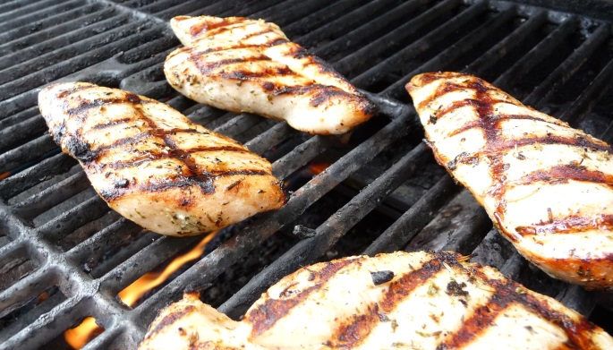
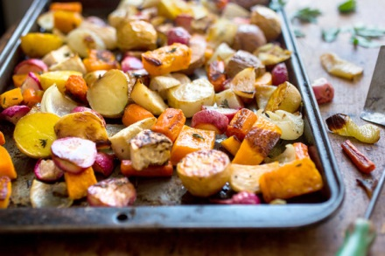
Healthy Cooking Methods

Slide 32
Healthy Menu Options
Choose
Instead of
Baked, broiled or grilled poultry, fish, or lean meat
Tomato sauces
Leafy green salad with vinaigrette
Brown rice or baked potato
Broth or veggie soups
Fruit-based dessert or sherbet
Water, coffee, tea, diet beverage or nonfat milk
Fried, buttered, sautéed, marbled, or breaded meats
Cream or butter sauces (ex. alfredo)
Caesar, potato, or pasta salad
French fries, mashed potatoes
Creamy soups
Cake or pie
Soda, lemonade, sweet tea, mixed coffee beverages, alcoholic drinks

Slide 33
Grocery Shopping
Non-starchy Vegetables
Starchy Vegetables
Fruit
Poultry & Meat
Fish & Seafood
Eggs
Milk
Dairy
Beans & Legumes
Whole-Grains
Spreads & Oils
Keep these portions small: potatoes, corn, peas
1-2 eggs per day most days is safe
Low-fat or non-fat Greek yogurt, cottage cheese and cheese
100% whole wheat bread, whole wheat pasta, brown rice, oatmeal, quinoa
Choose lean cuts
90%+ lean,
remove skin
Choose skim/non-fat or 1% for weight loss
Lentils, black beans, chickpeas, kidney beans, etc.
Nuts and Seeds
Olive oil, hummus, yogurt-based dips, oil-based salad dressing
Aim for 3-5 servings per day
Choose fresh or frozen
If canned, choose packed in water
Aim for 2 servings per week
Stick to the outside of the store!

Slide 34
Stretch Your Food Budget
Keep a running grocery list & stick to it.
Look for deals and sales at grocery stores.
Save with store brands.
Use coupons only when they same money.
Canned and frozen fruits and vegetables count.
Buy fish frozen
Drink Tap water

Slide 35
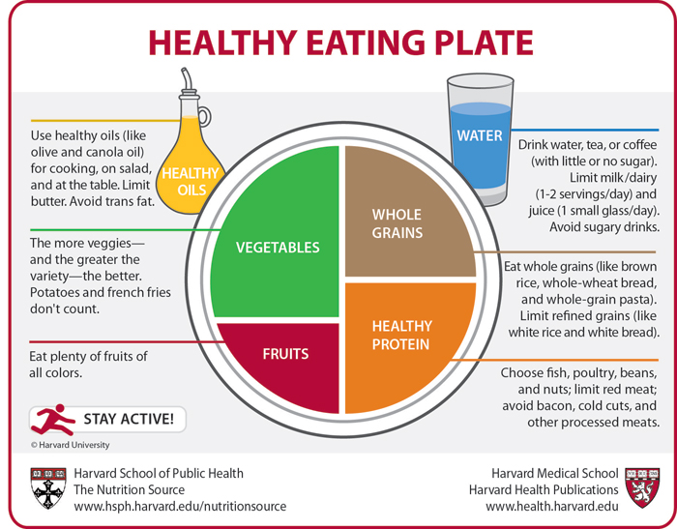
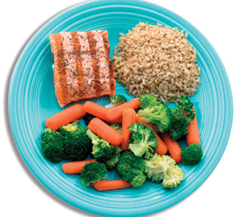
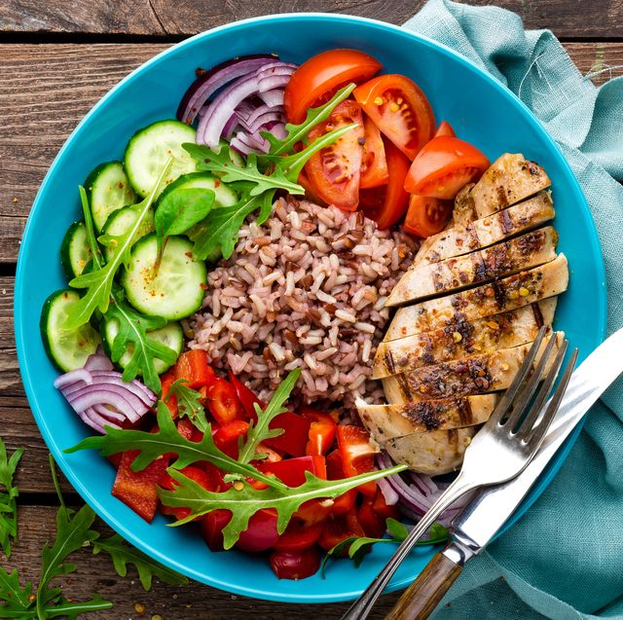
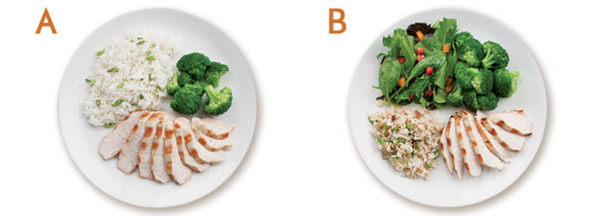
Portions and Healthy Plate
Choose a 9 inch plate for portion control!

Slide 36
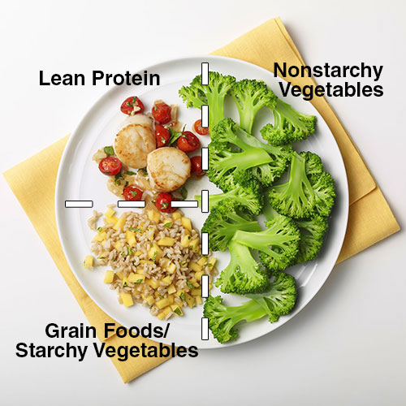
Picture Your Plate

Slide 37
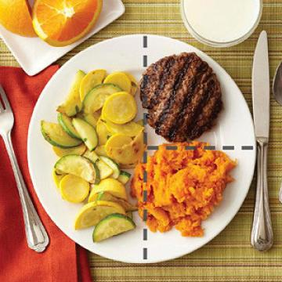
Picture your plate

Slide 38
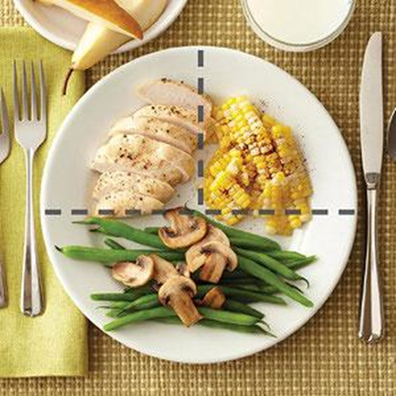
Picture Your Plate

Slide 39
Physical Activity
Aim for 150 minutes per week.

Slide 40
Good News About Physical Activity
Regular physical activity can help you:
Lose weight
Lower risk for heart disease
Reduce need for medication, possibly
Reduce symptoms of depression and anxiety
Gain energy
Increase well-being
Improve sleep quality
Increase strength, mobility, and stamina

Slide 41
Physical Activity: Keep it Fun
Choose activities you enjoy
Enjoy activity with a partner
Add variety to your daily routine

Slide 42
Diabetes Prevention Program

Slide 43
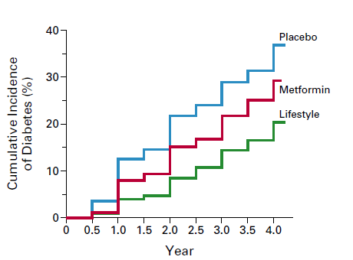
Diabetes Prevention Program – Randomized controlled trial in 3,234 participants at risk for diabetes
Goals of Intensive Lifestyle Intervention
7% weight loss
150 min/wk moderate intensity exercise
Intervention contacts
Trained interventionists
Weekly to monthly contacts
Goal-setting
Self-monitoring
Motivational interviewing
Diabetes Prevention Program Research Group. NEJM. 2002;346:393-403.

Slide 44
DPP
Program Elements
Eligibility
Prediabetes AND BMI ≥25 kg/m²
Instructors
CDC-certified DPP coaches
Format
Group
In-person or telemedicine
Topics
Nutrition
Physical activity
Stress/triggers
Healthy habits
Calorie balance
Self-monitoring
Diabetes & CVD
CDC curriculum
Program Goals: Physical activity ≥150 min/week, weight loss ≥5%

Slide 45
DPP
Benefits
Lower diabetes risk
Weight loss
Improve healthy behaviors
Improve quality of life
Improve blood pressure
Improve sleep
Decreased healthcare costs

Slide 46
Join a Program Today!
Diabetes Prevention Program:
ummidtown.org/dpp
Diabetes Self-Management Program:
ummidtown.org/dsmt

Slide 47
Recipe for success
3 servings of whole grains daily
3 cups of beans/legumes each week
½ plate of vegetables 2x/day
3 servings of fruit each day
6oz-8oz of lean protein per day (1/4 of your plate)
3 servings of low-fat dairy/calcium rich items
Snack on ¼ cup of nuts daily
8 (8 oz) of water daily
Sprinkle on the spice for flavor
Walk/play for 150 minutes a week (20 minutes a day)

Slide 48
Diabetes is a Journey…
Diabetes can be controlled!
You can thrive when living with diabetes!
You are not alone!
Type 2 Diabetes can be prevented!
Get a team to partner with you to manage your diabetes!

Slide 49
Questions & Answers

Slide 50
A recording of this webinar will be posted within 48 hours at www.umms.org/letstalk Previous webinars including Technology/Telehealth, Accessing Care/Ask Me 3®, Children’s Health/Safety, Men’s Health, Women’s Health, Diabetes, Lung Disease, COVID-19 Vaccines, Heart Health, Advance Directives, Asthma and Stroke Prevention, Fall Prevention, Alzheimer’s/Dementia, Long COVID & Pediatric COVID Vaccine, Pharmacy/Medication Management, Colon Cancer, Healthy Aging, PTSD Post Traumatic Stress Disorder, Vaping, Sickle Cell, Sudden Cardiac Arrest are also available for viewing.

Slide 51
Safe Toys and Gifts
Join us in December 21, 2022, 12:00 pm

Slide 52
Thank you!

