Slide 1
Long COVID and Vaccines for Children 12/15/2021

Slide 2
Today’s Speaker
Gregory Schrank, MD MPH
Dr. Greg Schrank attended medical school at the Lewis Katz School of Medicine at Temple University in Philadelphia. He went on to complete Internal Medicine residency training at the NYU School of Medicine, where he also served as a chief medical resident, followed by a fellowship in Infectious Diseases at Beth Israel Deaconess Medical Center/Harvard Medical School. While there, he completed additional fellowship training in infection control and hospital epidemiology. After fellowship, Dr. Schrank joined the faculty at the University of Maryland School of Medicine as an Assistant Professor of Medicine in the Division of Infectious Diseases. He sees patients at the R Adams Cowley Shock Trauma Center and serves as an Associate Hospital Epidemiologist for the University of Maryland Medical Center. During the COVID-19 pandemic, he served as an Incident Commander for the COVID-19 response at the University of Maryland Medical Center during the Spring and Fall surges of 2020 and more recently as a subject matter expert for University of Maryland Medical System’s vaccination efforts.

Slide 3
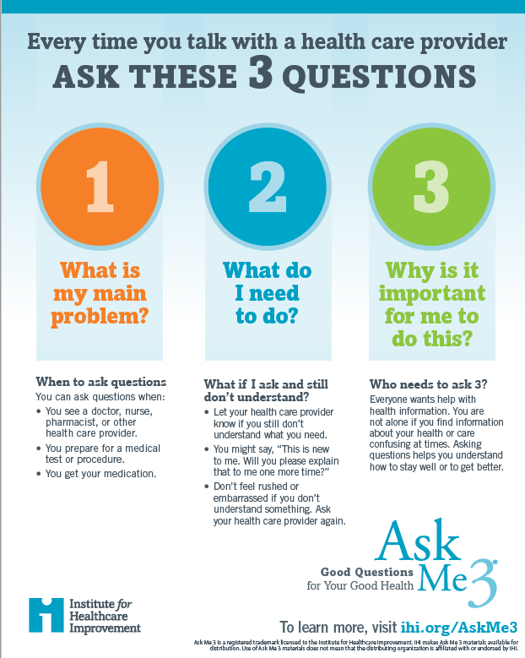
A Way to Take Charge- Use Ask Me 3®
Ask Me 3 is a program that suggests using three simple, straightforward questions when talking to your doctor, nurse, pharmacist or health care provider about your health:
What is my main problem?
What do I need to do?
Why is it important for me to do this?

Slide 4
“Long COVID”
What we know so far

Slide 5
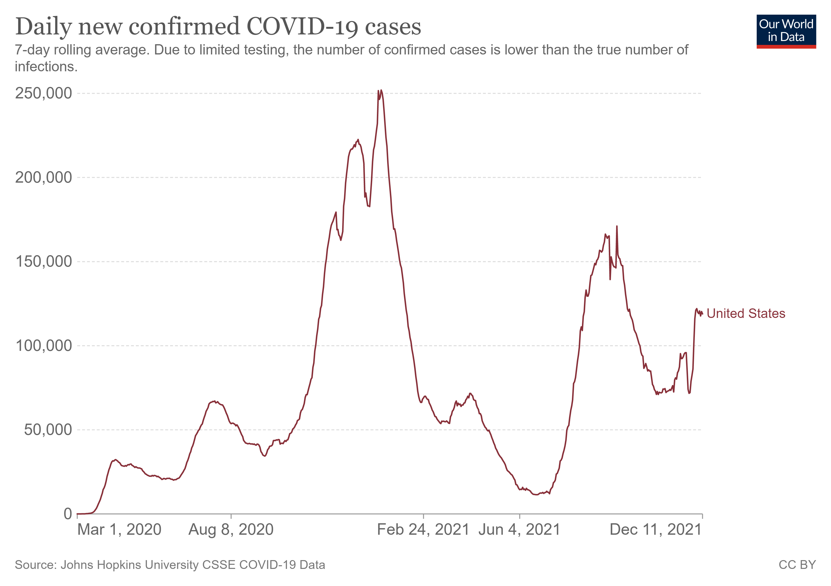
The COVID-19 Pandemic
About 14% of COVID-19 cases are severe and require hospitalization
Age
Medical conditions
Social determinants
Cases | 49 million
Deaths | 797,000
Ourworldindata.org
Johns Hopkins University Coronavirus Resource Center
Stokes EK et al. CDC MMWR 2020
Notes:
Morbidity and social/economic implications that last well beyond acute illness and hospitalization

Slide 6
Post-Sepsis and Post-ICU Syndrome
Before the pandemic: A clear link between sepsis/critical illness and long-term symptoms
Post-intensive Care Syndrome – symptoms that remain after critical illness
ICU-acquired weakness: Half of patients in the ICU for at least one week
Cognitive dysfunction (difficulty with thoughts): 30-80% of patients
Post-traumatic Stress Disorder (PTSD): depression, anxiety, difficulty with sleep
Post-sepsis – severe or critical illness due to an infection
Over 1 million individuals in the US survive an episode of sepsis each year
One-sixth have persistent physical disability
Many are readmitted to the hospital: 12% of all US hospital readmissions
One-third die in the year following the sepsis episode
SCCM.org
Prescott HC. JAMA 2018.
Mayr FB. JAMA 2017.
Iwashyna TJ. JAMA 2010.

Slide 7
Post-Sepsis Clinical Course
Prescott HC. JAMA 2018.

Slide 8
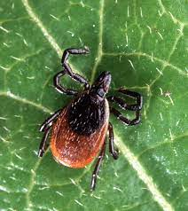
Symptoms After Other Infections
Post-treatment Lyme Disease Syndrome
5-15% of people infected with Lyme Disease
Fatigue, muscle or joint pain, and difficulty thinking persisting for 6 months after antibiotic treatment
Myalgic Encephalomyelitis (Chronic Fatigue Syndrome)
Possible relationship with Epstein-Barr virus, the cause of mononucleosis
Can be sudden in onset along with other symptoms of viral infection
Severe fatigue with chronic bone or muscle pain
Painful lymph nodes may be present
Treatment is targeted to symptoms.
Feder HM. NEJM 2007.
Lantos PM. Clin Infect Dis 2021.
Hickie I. BMJ 2006.
Jones JF. Ann Intern Med 1985.
Image: The Independent, May 2021.

Slide 9
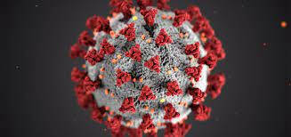
What is “Long COVID”?
Different names
Long COVID or long haulers
Post-COVID conditions
Post-acute sequelae of SARS-CoV-2 infection (PASC)
Physical and mental symptoms that develop during or after COVID-19 and continue for at least 2 months (3 months from onset of COVID-19 illness)
Lack of return to usual state of health
Not explained by an alternative diagnosis
Not related to the active viral infection
CDC.gov

Slide 10
Why Does it Occur?
Exact cause remains unknown and an active area of research
Potentially due to the body’s immune response to infection
Triggers a reaction that can cause ongoing tissue injury and inflammation
Ledford. Nature 2021.
Di Sante. medRxiv pre-print 2021.

Slide 11
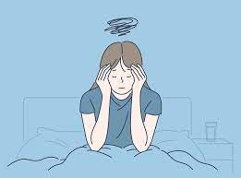
Who is at risk for Long COVID?
Can affect people across the spectrum of COVID-19 illness
Mild to severe disease requiring hospitalization
Estimated to affect 10-50% of people after infection
Likely impacts millions in the US though exact number unknown
Risk after infection varies by study
Prognosis and time to improvement is variable
May depend on baseline health and severity of symptoms
Can last for months – even among those with initial mild COVID infection
CDC.Gov
Menges D. PLOS One 2021.
Augustin M. Lancet Europe 2021.

Slide 12
What are some of the symptoms?
Brain fog/Poor Memory
Headache
Sleep problems
Lightheadedness
Anxiety
Loss of Taste
Changes in Taste
Loss of Smell
Cough
Shortness of Breath
Muscle pain
Joint pain
Severe fatigue
Impaired function
Chest pain
Palpitations
Poor appetite
Diarrhea
Notes:
Some may persist, others may be new and late-onset, others are changing symptoms

Slide 13
Using Ask Me 3®
Statement (problem)
Two months ago, I was diagnosed with COVID when I was tested before traveling. I only had a runny nose and headache at the time, but now I feel so tired I can hardly manage to leave the house and often feel like I can’t remember things I did earlier in the day.
Q: What is the problem?
A: Long COVID or Post-COVID Conditions can occur in up to 50% of adults after infection, even if the initial symptoms were mild.
Q: What do I need to do?
A: Talk to your doctor who can help to determine if these symptoms are related to your prior COVID-19 infection or if they have another cause.
Q: Why is it important for me to do this?
A: Long COVID can significantly impact a person’s life, including their ability to work and perform day-to-day activities. Seeing your doctor is an important first step in developing a treatment plan.

Slide 14
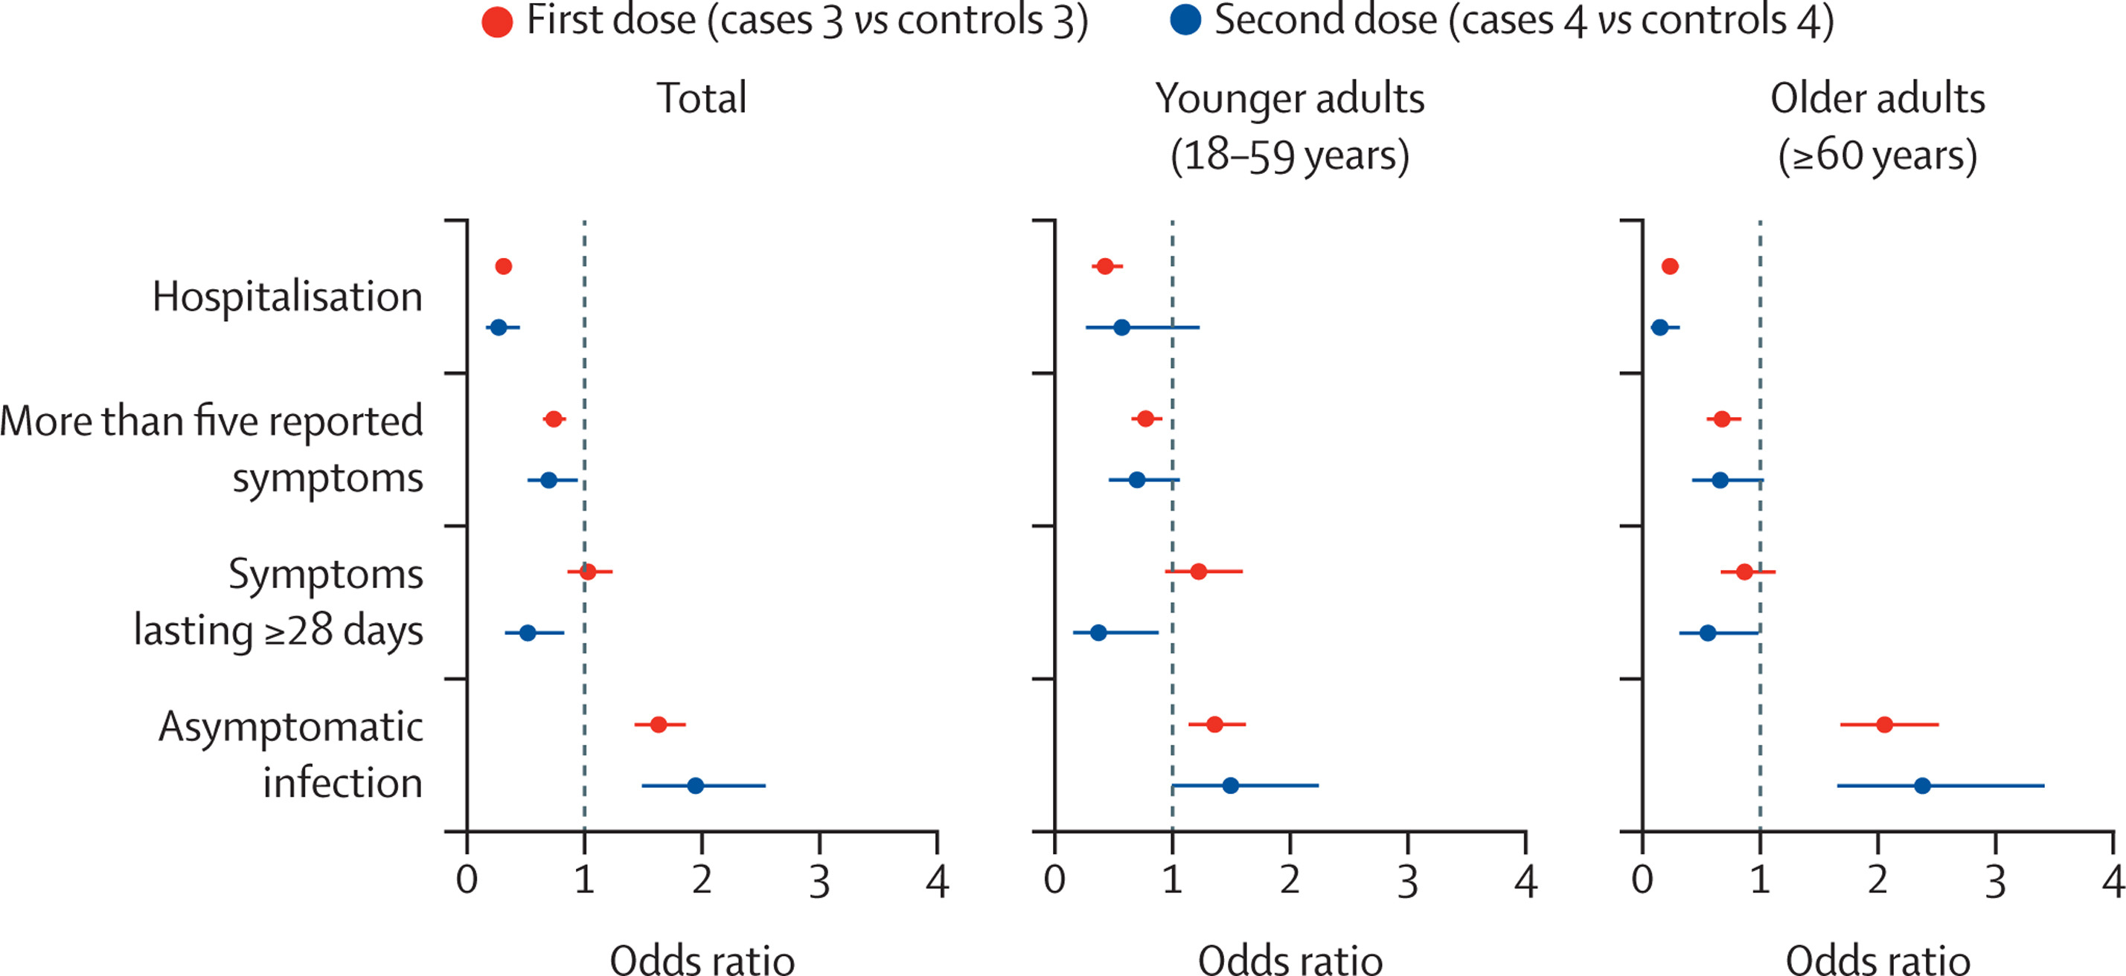
How Does Vaccination Affect the Risk of Long COVID?
An active area of research
One study in the UK of over 1 million people identified a lower odds of symptoms lasting >28 days among vaccinated people
Other studies have suggested that vaccination may improve the severity of symptoms
Antonelli M. Lancet Infectious Diseases 2021.
Arnold DT. medRxiv 2021.

Slide 15
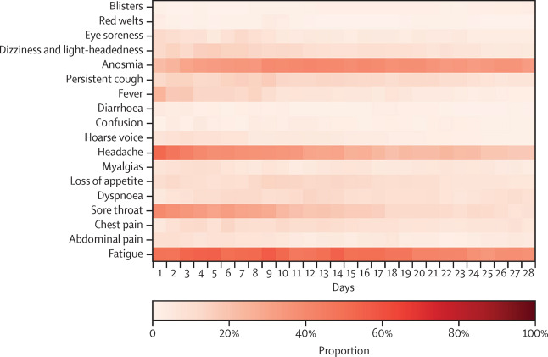
Are Children at Risk of Long COVID?
Fewer studies looking at risk in children
May be less common in children but exact risk is unknown
Ranges 0-13%
Signs of ongoing inflammation among those with symptoms
Symptoms are similar
Fatigue
Shortness of breath
Difficulty concentrating
May resolve faster than in adults but more study needed
Buonsenso D. Acta Pediatr 2021.
Brackel CLH. Pediatric Pulmonology 2021.
Radtke T. JAMA 2021.
Molteni E. Lancet Child and Adolescent Health 2021.

Slide 16
Using Ask Me 3®
Statement (problem)
I have three children at home. Two of them are too young to be vaccinated and go to day care. My oldest child is in middle school and has a learning disability. I worry about their risk of getting COVID, especially because there is so much we don’t know about long term symptoms.
Q: What is the problem?
A: COVID-19 can infect children and lead to long term symptoms, just like in adults.
Q: What do I need to do?
A: If your child is eligible, getting them vaccinated reduces their risk of infection. If you have questions about the vaccine, talk to your child’s pediatrician. When more people in the family are vaccinated (and boosted) it makes the entire family safer – especially the vulnerable and very young.
Q: Why is it important for me to do this?
A: Vaccination is the best tool we have to prevent the spread, infection, and the complications of COVID-19

Slide 17
COVID-19 Vaccines and Children
Protecting our youngest

Slide 18
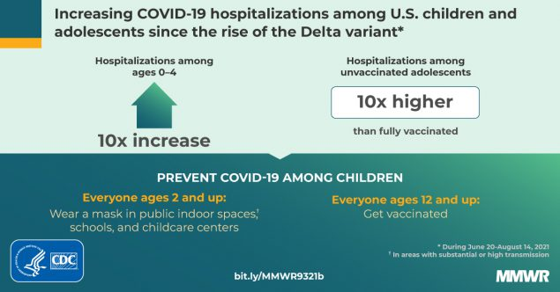
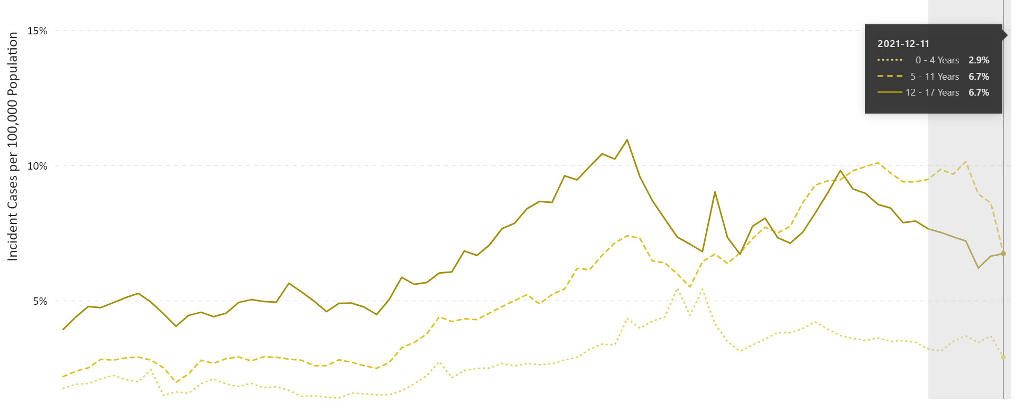
Kids and the COVID-19 Pandemic
Over 7 million cases of COVID-19 among children
Likely underestimated
Increasing
17% of all cases
2-4% of hospitalizations
Currently 1% in MD
Percentage of all COVID-19 cases amongst kids in Mid-Atlantic
CDC.Gov
American Academy of Pediatrics
Maryland Department of Health
Delahoy MJ. CDC MMWR 2021.

Slide 19
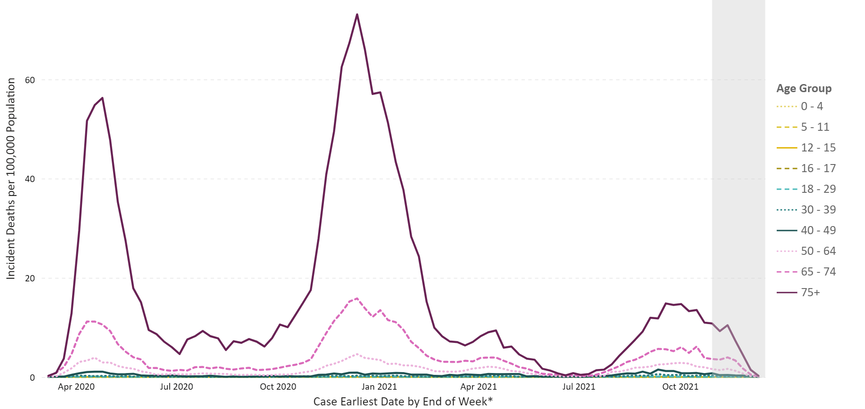
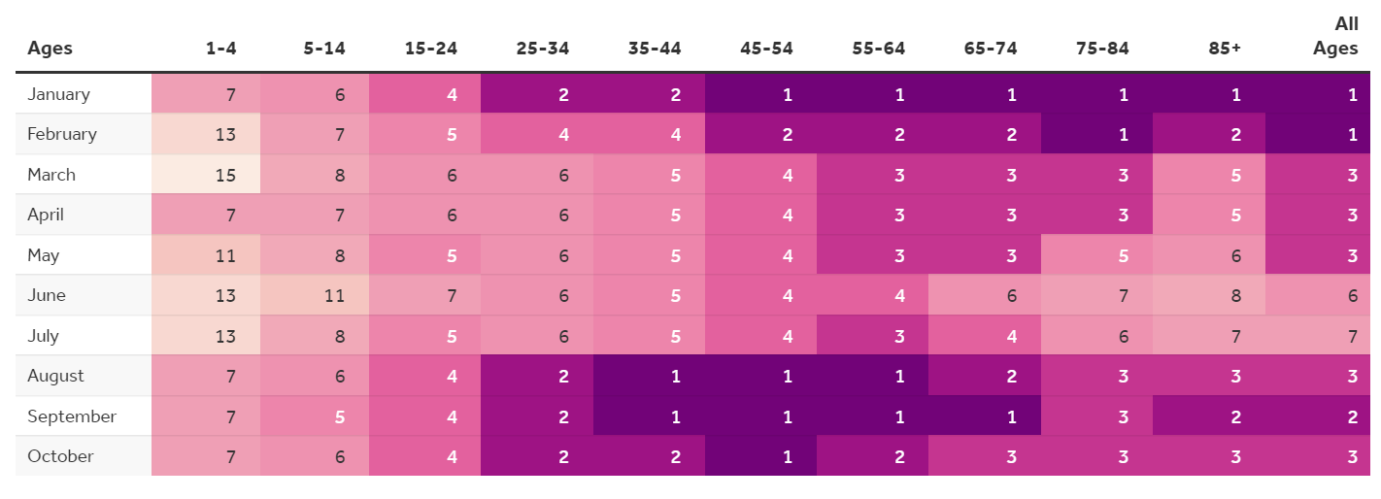
Severe Outcomes Are Less Common But Still Occur
CDC.Gov
Kaiser Family Foundation

Slide 20
Multisystem Inflammatory Syndrome
Average age 9 years
Most between 5-11
Leads to hospitalization
Over 100 cases reported in Maryland
CDC.gov

Slide 21
Missed School
Learning loss due to the pandemic
Isolation for COVID-19 infection
Quarantine for exposures
Social and emotional impact of remote learning
Vaccination lowers the risk of infection
Reduces transmission to others, even when breakthrough infection occurs
Lipsitch M. Nature Reviews Immunology 2021.

Slide 22
Using Ask Me 3®
Statement (problem)
I have a 6-year-old daughter with asthma. She needs to use an inhaler everyday and has even been hospitalized with an exacerbation. I worry about what would happen if she got infected with COVID-19, but I am also unsure about the possible side effects of the vaccine.
Q: What is the problem?
A: COVID-19 is less severe in children but can still rarely cause serious illness and lead to hospitalization. This is especially true for kids with underlying health conditions.
Q: What do I need to do?
A: Talk to your child’s pediatrician about your concerns. Speak to trusted friends and family who have taken their children to get vaccinated. Read about the vaccine from a trusted source like the CDC.
Q: Why is it important for me to do this?
A: Even if rare, even one serious complication from COVID in a child is one too many. Vaccines are a safe and effective way at preventing severe infection and making sure your child stays safe during the pandemic.

Slide 23
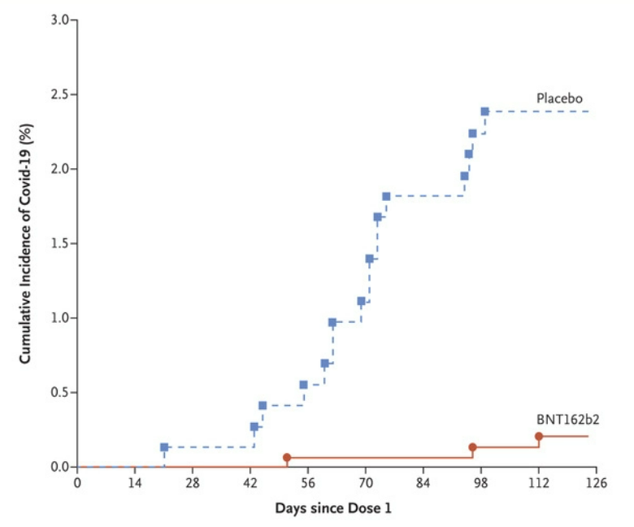
COVID-19 Vaccine for Ages 5-11
Pfizer vaccine authorized for kids 5-11 in early November
Clinical Trial
Randomized 2:1 to receive vaccine or placebo
Lower dose than used in adults/kids >12
~2200 kids at 90 sites in 4 countries
79% white, 6% Black, 7% Multiracial
21% Hispanic/Latino
90% vaccine effectiveness
Walter EB. NEJM 2021.

Slide 24
Vaccine Safety and Side Effects
Side effects similar to those seen in adults
Less common
Mild to moderate and last 1-2 days
5 million doses given to 5–11 year-olds across the US so far
No serious safety signals
No cases of myocarditis identified
Studies in younger children ongoing
Walter EB. NEJM 2021.
CDC.gov

Slide 25
Questions & Answers

Slide 26
A recording of this webinar will be posted within 48 hours at www.umms.org/letstalk Previous webinars including Technology/Telehealth, Accessing Care/Ask Me 3®, Children’s Health/Safety, Men’s Health, Women’s Health, Diabetes, Lung Disease, COVID-19 Vaccines, Heart Health, Advance Directives, Asthma and Stroke Prevention, Fall Prevention, Dementia, Long COVID and Pediatric COVID Vaccines are also available for viewing.

Slide 27
Pharmacy and Medication Management
Join us in January 19, 2022, 12:00 pm

Slide 28
Thank you!

